Slide 1
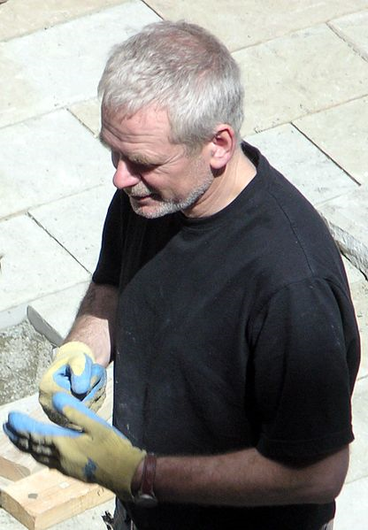
Our next project is about the artist, Andy Goldsworthy
Andy was born on the 26th July, 1956.
He is from Cheshire in Great Britain.

Slide 2
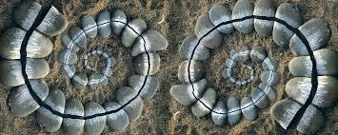
Andy Goldsworthy is a British artist who produces natural sculptures and environmental and land art.

Slide 3
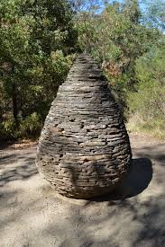
Andy Goldsworthy produces artwork using natural materials (such as flowers, mud, ice, leaves, twigs, pebbles, boulders, snow, thorns, bark, grass and pine cones).

Slide 4
Much of his work is made outside and is meant to be temporary. He photographs the artwork and then allows it to remain in the natural environment and decay at its own rate. Sometimes he photographs the same work in different conditions.

Slide 5
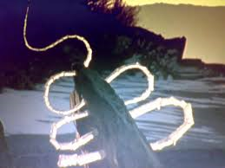
Goldsworthy says he ‘works with nature as a whole’ and he often doesn’t use man-made tools to produce his land art. (His ice sculptures are often stuck together using saliva!)

Slide 6
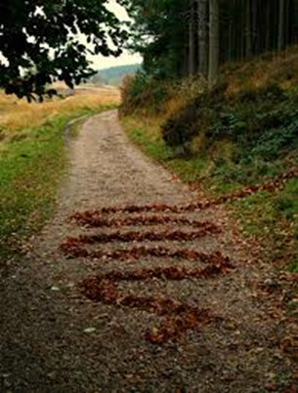
He has shown his work in many exhibitions and he has published several books containing photographs of his environmental art, including: Arch, Wood, Passage, Enclosure and Stone.
(This is how he earns money and makes a living)

Slide 7
Lesson 1: WatchYouTube clips on Goldsworthy, here are a couple of suggestions. Write notes about Goldsworthy and his work for lesson 2:
https://www.youtube.com/watch?v=USgiTXAEC9E
https://www.youtube.com/watch?v=GlE7q-QP4m4 (water wall art)

Slide 8
Lesson 2 :Write about Andy Goldsworthy
Where is Andy Goldsworthy from?
When was he born, is he still alive?
What is his type of art called?
Describe Andy Goldsworthy’s work (what is it usually
made of? Where can it be found? …..)
Write what you think about his work, do you like it? Why do you think that.

Slide 9
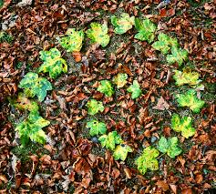
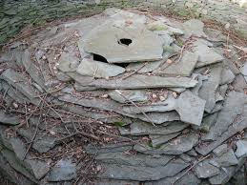
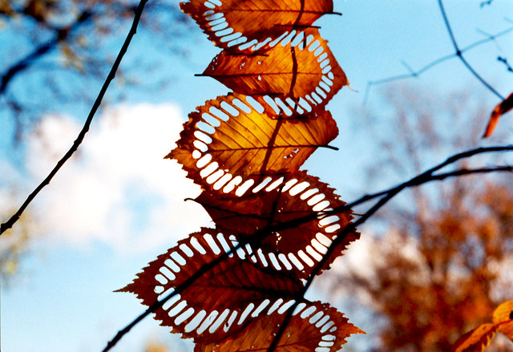
Lesson 3: Make your own piece of work out of objects from nature (ask if you want to use growing plants or flowers):
Do not forget to photograph it

Slide 10
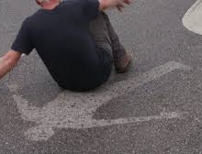
Lesson 4: Make a water shadow piece of art work, you could spray water over anything!

Slide 11

Email photographs of your work to Mrs Phillips and / or stick them in your book!

