Slide 1
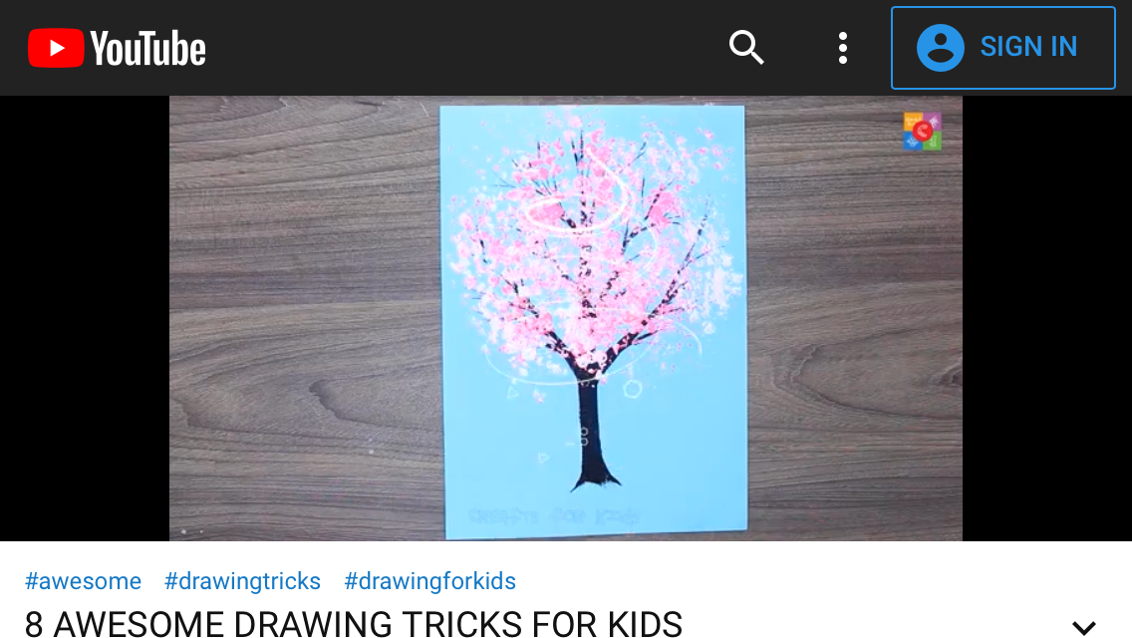
Painting Trees

Slide 2
Lesson 1: On one page (if possible on plain paper) Sketch some trees / parts of trees!
Ideally go outside and sketch from real life, if you can not, use photographs from the internet.
Fill the page with approximately 4 small sketches, try to show the shape and textures on the tree.

Slide 3
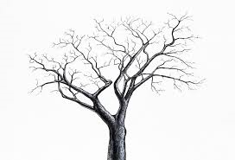
Lesson 2: Sketch 1 tree, A4 size, without leaves or blossom.

Slide 4
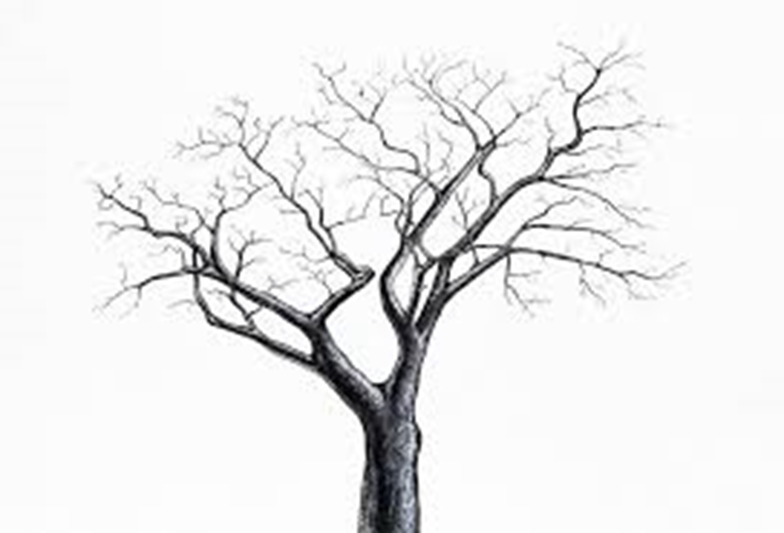
Lesson 3
Copy the tree two more times
Either: tape the original on a window, put plain paper on top and trace it.
or photocopy it.

Slide 5
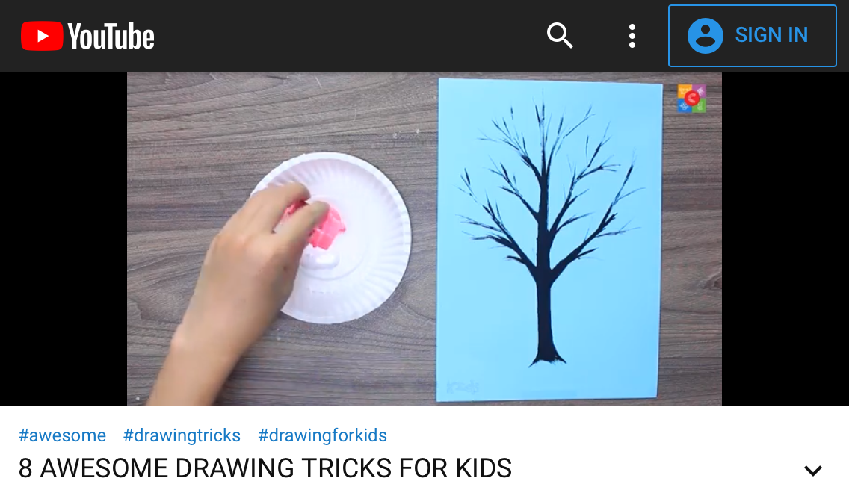
Lesson 4 - 5 - Watch this YouTube clip: https://www.youtube.com/watch?v=vY49eNceLBo

Slide 6
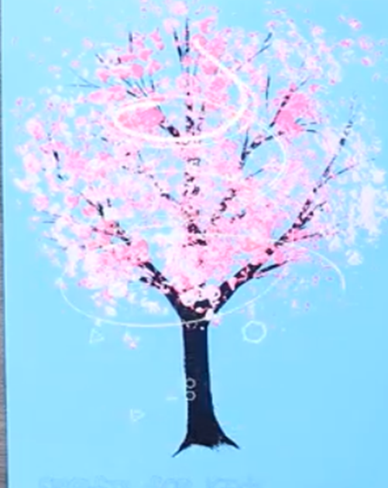
Choose as many techniques as you want to (at least 2), from the YouTube clip, and try them out!

Slide 7
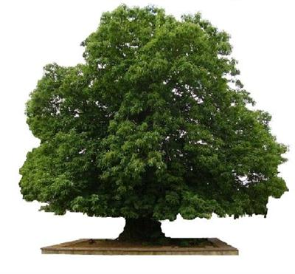
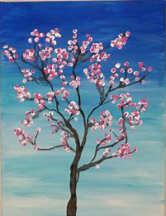
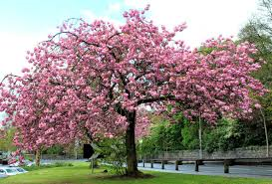
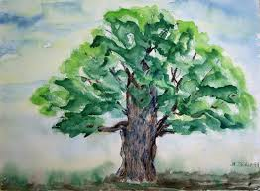
Lesson 6 - 8
Make your own version of the Parkfields tree or your favourite tree. Use any media or one of the ones that you have learned.
Have fun! Email Mrs Phillips some photographs of your masterpieces.

