Slide 1
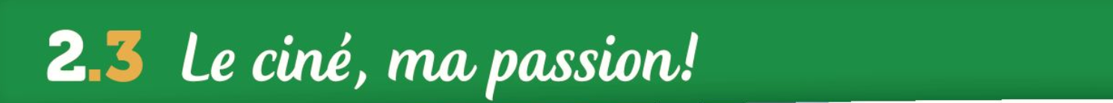
lundi, onze mai
L’Objectif:
nommer des genres de films
donner ton opinion
faire un résumé d’un film (le passé)

Slide 2
Je les déteste.
Je les adore.
Je les aime.
Je ne les aime pas

Slide 3
Je les déteste. I hate them
Je les adore. I love them
Je les aime. I like them
Je ne les aime pas I don’t like them

Slide 4
I hate it/that.
I love it/that.
I like it/that.
I don’t like it/that.

Slide 5
Je déteste ça.
J’adore ça.
J’aime ça.
Je n’aime pas ça

Slide 6
I hate it.
I love it.
I like it.
I don’t like it.

Slide 7
Je le déteste.
Je la déteste.
Je l’adore.
Je l’adore.
Je l’aime.
Je l’aime.
Je ne l’aime pas.
Je ne l’aime pas.

Slide 8
I hated the film.
I loved the film.
I liked the film.
I didn’t like the film.

Slide 9
J’ai détesté le film.
J’ai adoré le film.
J’ai aimé le film.
Je n’ai pas aimé le film.

Slide 10
Je l’ai détesté le film.
Je l’ai adoré le film.
Je l’ai aimé le film.
Je ne l’ai pas aimé le film.

Slide 11
How would you say: I saw …?
Remember the ‘magic number’…
1 2 3
Person Present tense(avoir) Past Participle
Je
ai

Slide 12
How would you say: I saw …?
Remember the ‘magic number’…
1 2 3
Person Present tense(avoir) Past Participle
J’
ai
vu
Je

Slide 13
I saw = J’ai vu
How do you say : I saw the film.
1. J’ai vu le film .
How do you say : I saw it (the film=le film)?
1. Je l’ai vu !

Slide 14
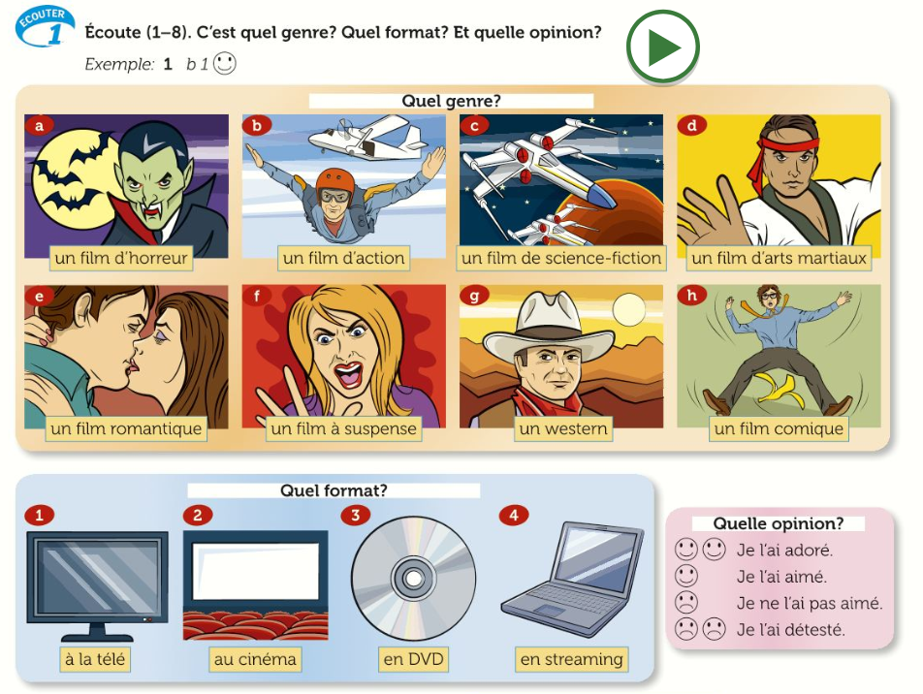

Slide 15
Hier, j’ai vu un film d’action en DVD.
Je l’ai aimé.
C’était divertissant et amusant.
1. Yesterday, I saw an action film on DVD.
I liked it.
It was entertaining and funny/amusing.

Slide 16
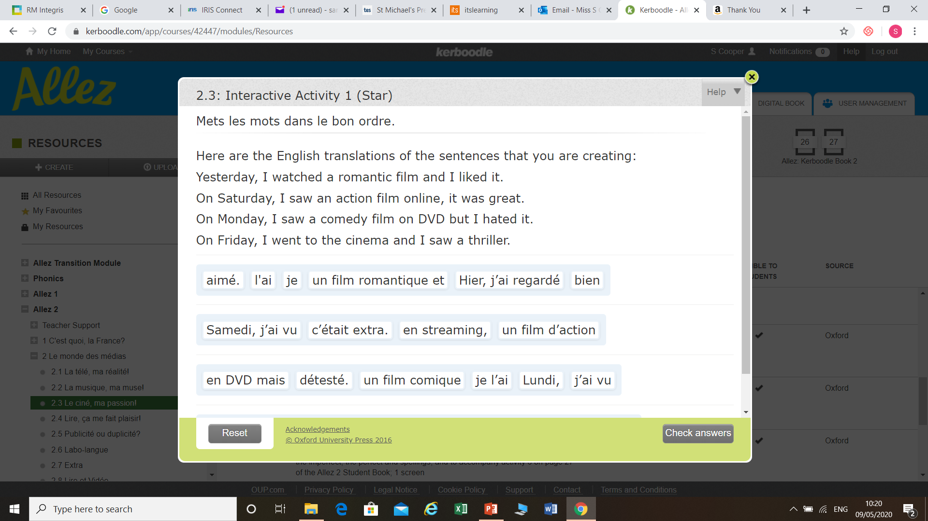

Slide 17
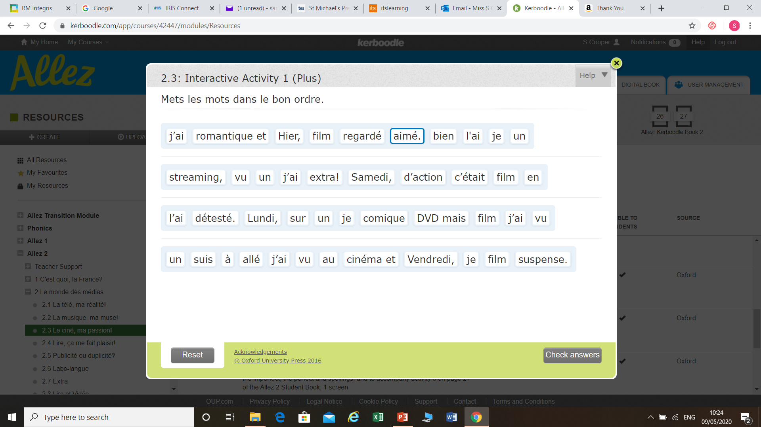

Slide 18
On Saturday, I saw a horror film at the cinema.
I loved it.
It was scary and terrifying.

Slide 19
On Saturday, I saw a horror film at the cinema. I loved it.
It was scary and terrifying.
Le samedi, j’ai vu un film d’horreur au cinéma.
Je l’ai adore.
C’était effrayant et terrifiant.

Slide 20
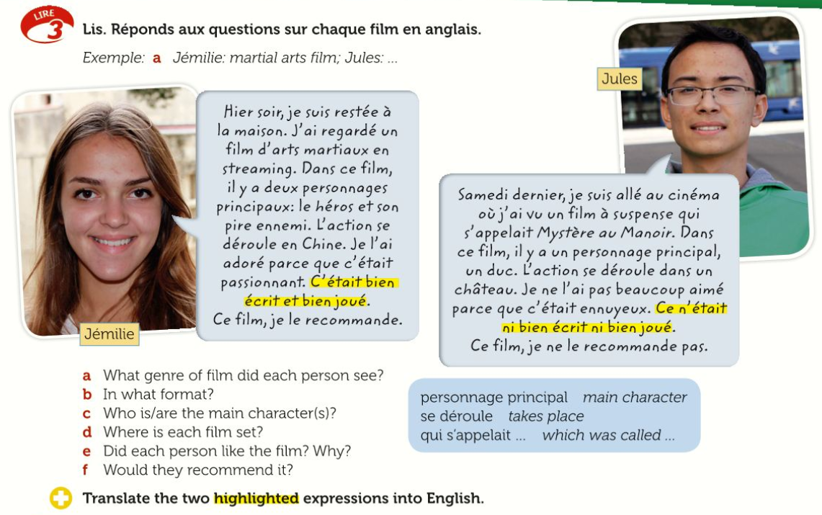

Slide 21
Jémilie: martial arts Jules: thriller (suspense)
Jémilie: via streaming Jules: at the cinema
Jémilie: hero and enemy Jules: a duke
Jémilie: in China Jules: in a castle/manor
Jémilie: loved it / exciting Jules: didn’t like very much / boring
Jémilie: Yes Jules: No

Slide 22
C’était bien écrit et bien joué
It was well written and well acted.
Ce n’était ni bien écrit, ni bien joué.
It was neither well written nor well acted.

Slide 23
 | Genre | Opinion | Détails
Lié par le sang | Horror
Mission sur Mars
Les sonnets perdus

Slide 24
 | Genre | Opinion | Détails
Lié par le sang | Horror | Hated: boring and childish | In castle; badly written and badly acted; not recommended
Mission sur Mars | Science-fiction | Liked a lot: exciting | In space ship; encounter a disaster on way to colonise planet; recommended
Les sonnets perdus | War and history | Loved: interesting and charming | In London; in 1960s; a French and German veteran from WW1 become friends; well written and acted

Slide 25
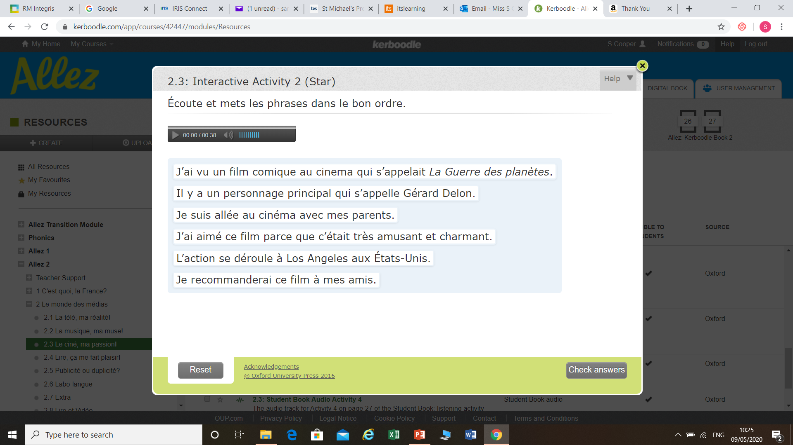

Slide 26
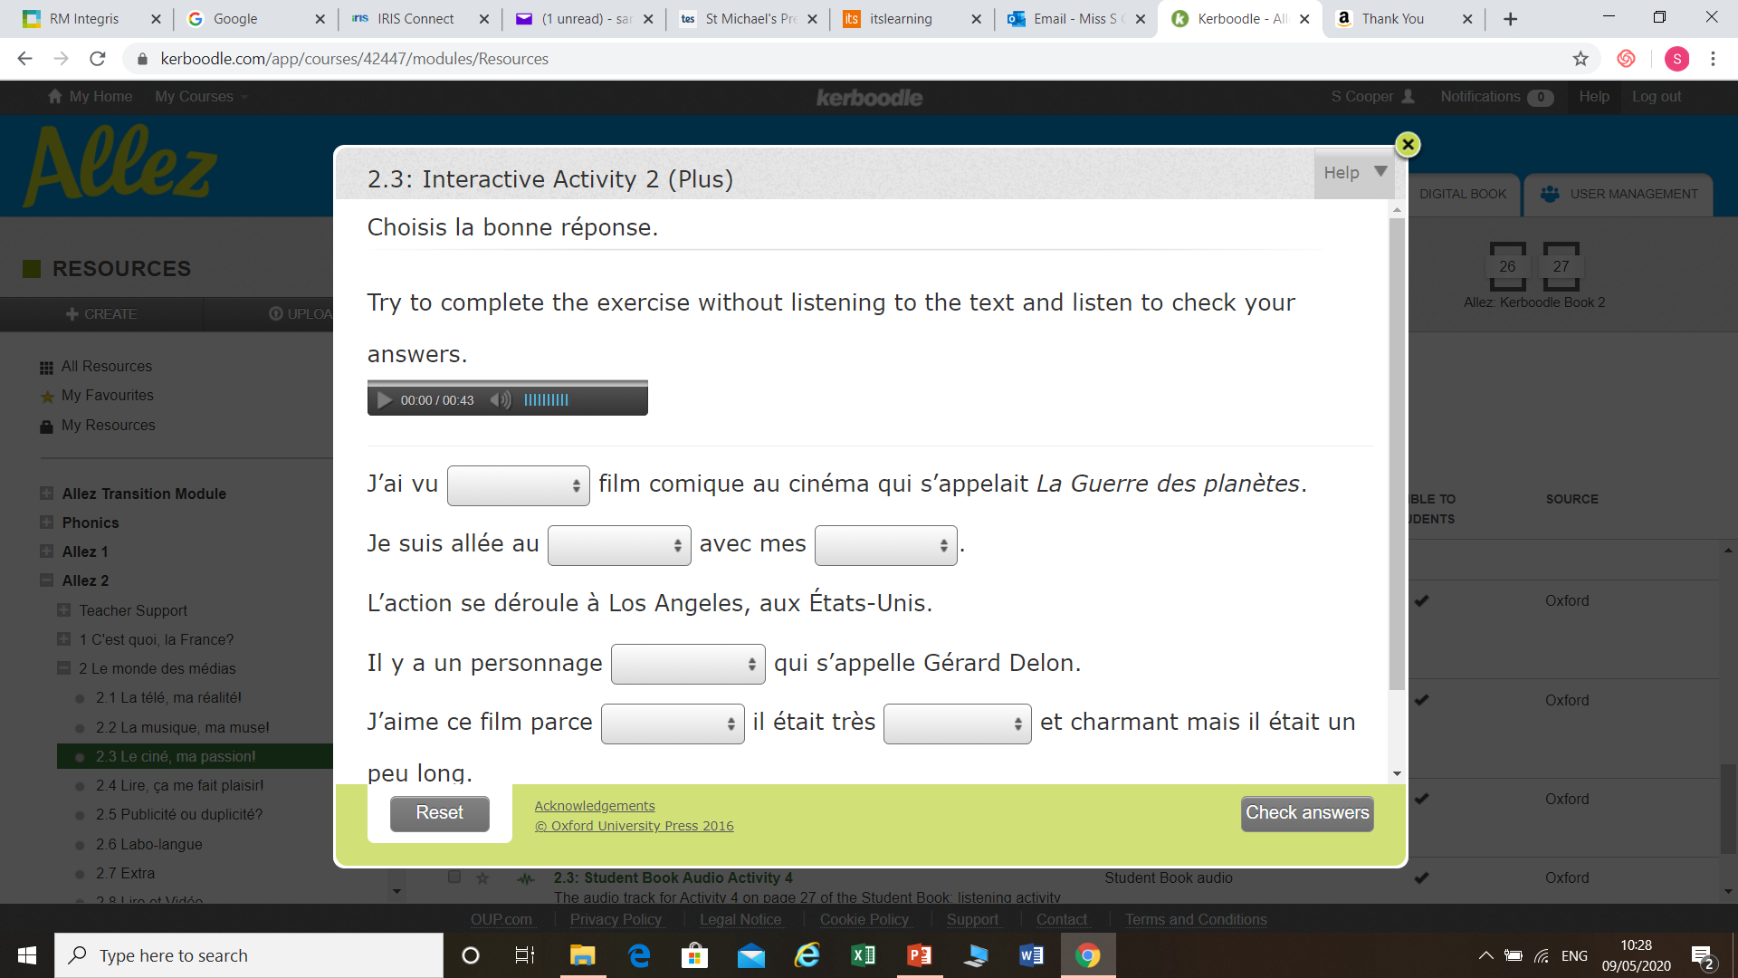

Slide 27
On _________ , I saw a _______ (type) film _______________ (how).
I ______ it (opinion).
It was ______________ (reason).

Slide 28
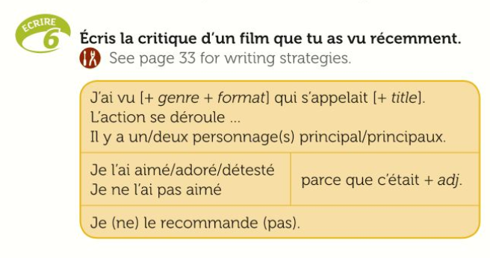

Slide 29
Now review your three answers to the speaking questions on kerboodle:
Say what you like watching on TV with reasons
Say what you like listening to and why
Say which film you saw last, when, how, opinion and reason.

