Slide 1
lundi, vingt-sept avril
L’Objectif:
découvrir les verbes en français
(to find out about French verbs)

Slide 2




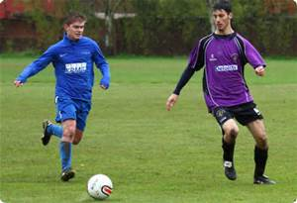
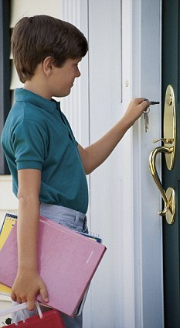
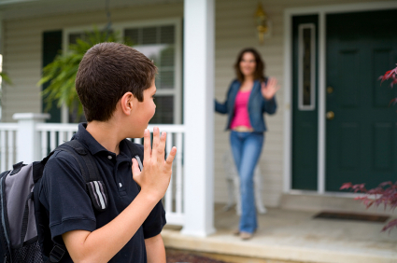
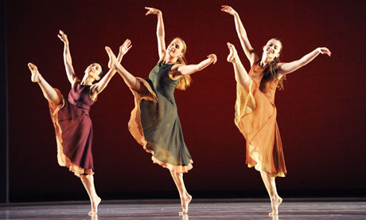
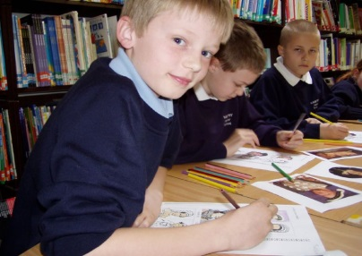
Notes:
Memory retrieval – test each other: pairs and whole class.

Slide 3
What did we find out about
French verbs?
écouter
manger
regarder
jouer
quitter
arriver
danser
travailler
Notes:
Discuss in pairs and then share ideas. Then write in exercise books what we have found out about verbs in French.

Slide 4
Summarise and memorise what we know so far:
tell us what the action is
there is a green bit (the stem)
there is a red bit (the ending)
they end in ‘-er’
the ending ‘-er’ means ‘to…’

Slide 5

Getting to know your dictionary:
Notes:
What does a dictionary normally do? This is slightly different because it is a bi-lingual dictionary. Bi means two as in bicycle binary: two languages. Really it is two dictionaries in one! Be careful to think before you look about the word you are looking up and then …

Slide 6
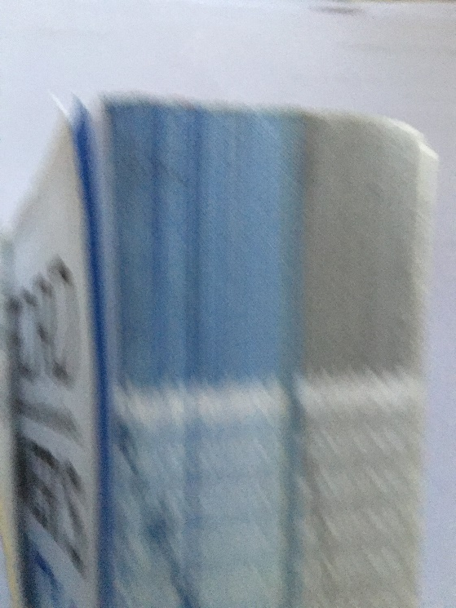
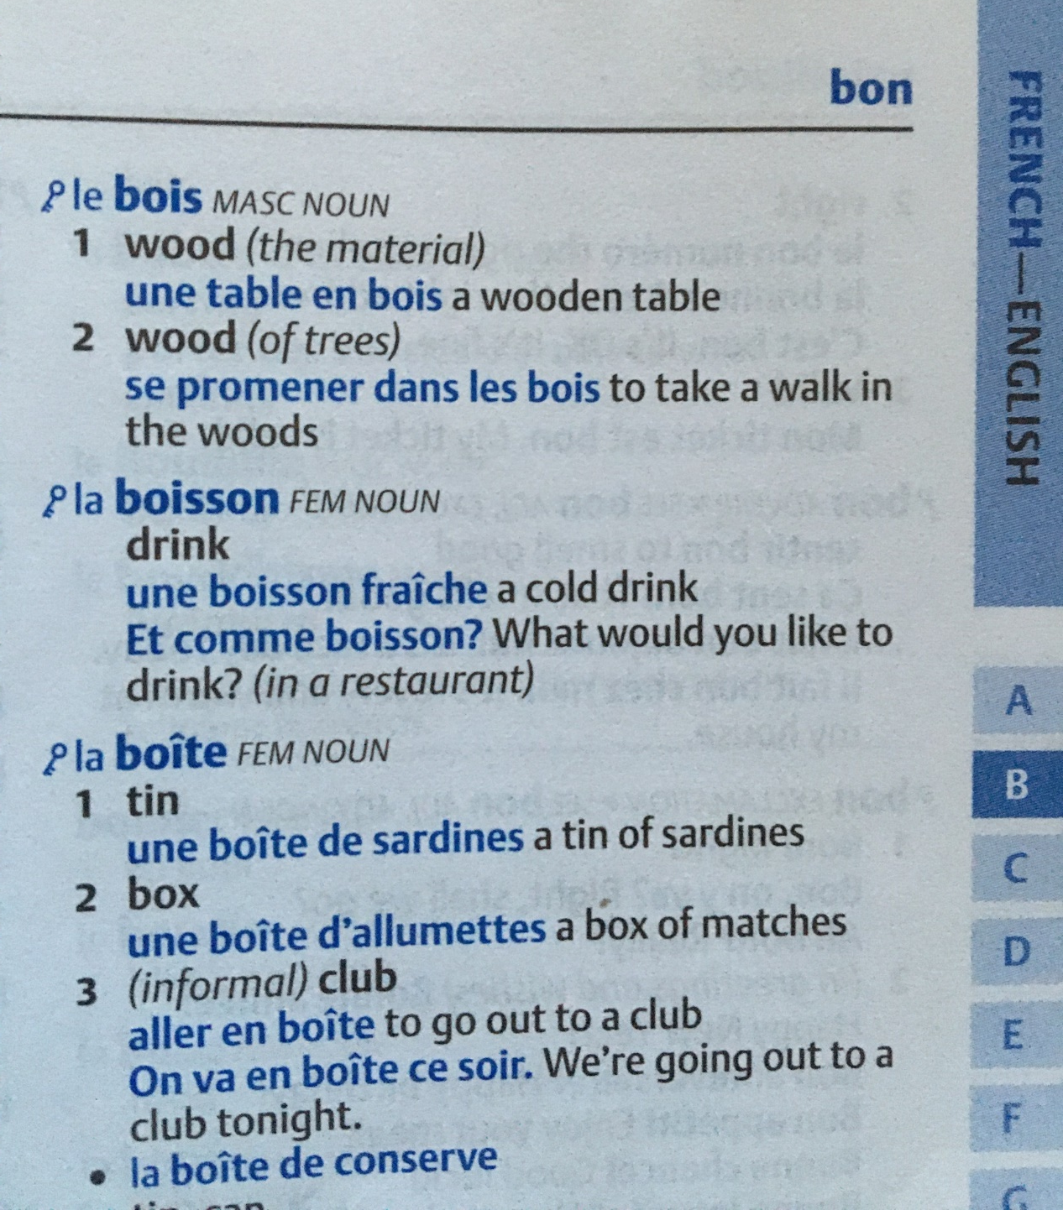
Notes:
… look in the right half. There is a blue half and a grey half. Look at the second picture and think about whn you would look in the blue half. Look up the French word ‘boisson’ and the dictionary tells you that the word for ‘the’ is ‘la’ and therefore it is a feminine noun; in black it tells you the meaning of the word in English, which is … ‘drink’ not the action but the thing, as in a or the drink. Afterwards, it gives you some examples of how it is used in a phrase: une boisson fraiche is a cold drink note it is not the action I drink a cup of tea…!

Slide 7
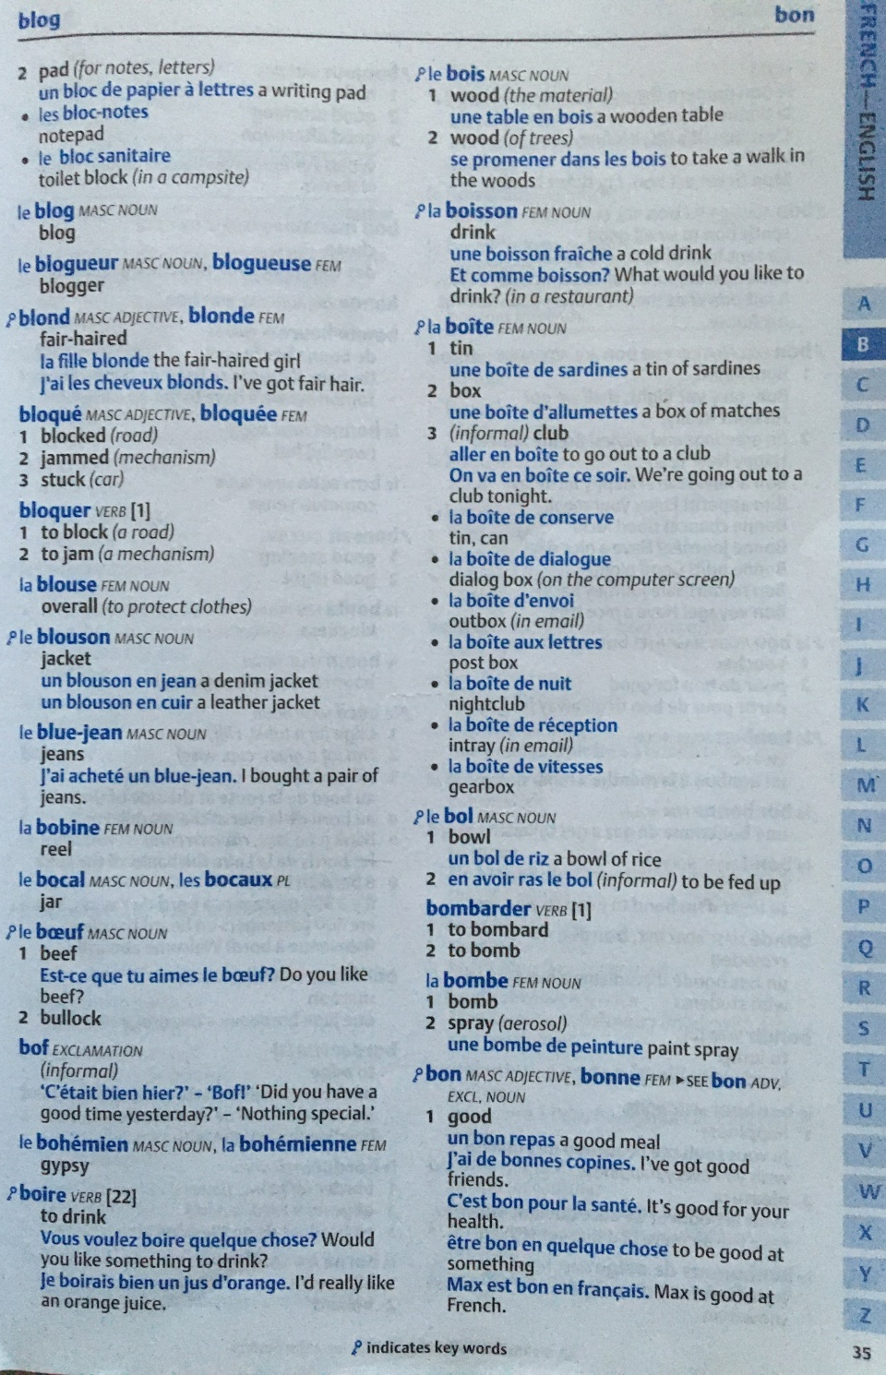
Notes:
Alphabetical order and the first word and last word are at the top of the page: blog is here and is the first full entry on the page. and bon is the last. Remember everything is in alphabetical order and the tabs help you find things – see the side of the page and the spine.

Slide 8
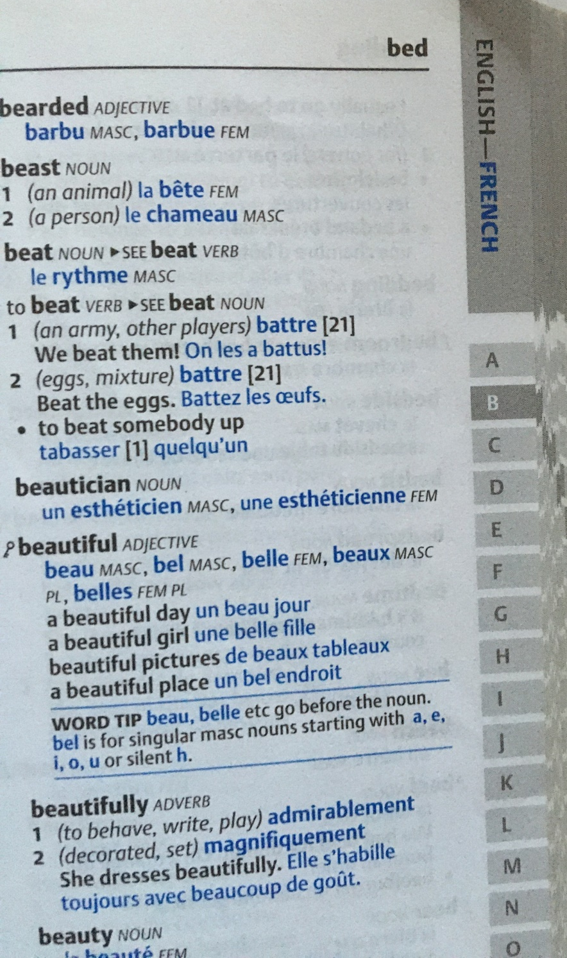
Notes:
How is this page different to the first one? Grey, English word is first (in black – same as in the first half when the languages are the other way around). The other information is all the same – noun, verb, meaning, example/context. Notice if it is an adjective, it will give you the masculine and feminine spelling. There are other hints and helps as we go through.

Slide 9
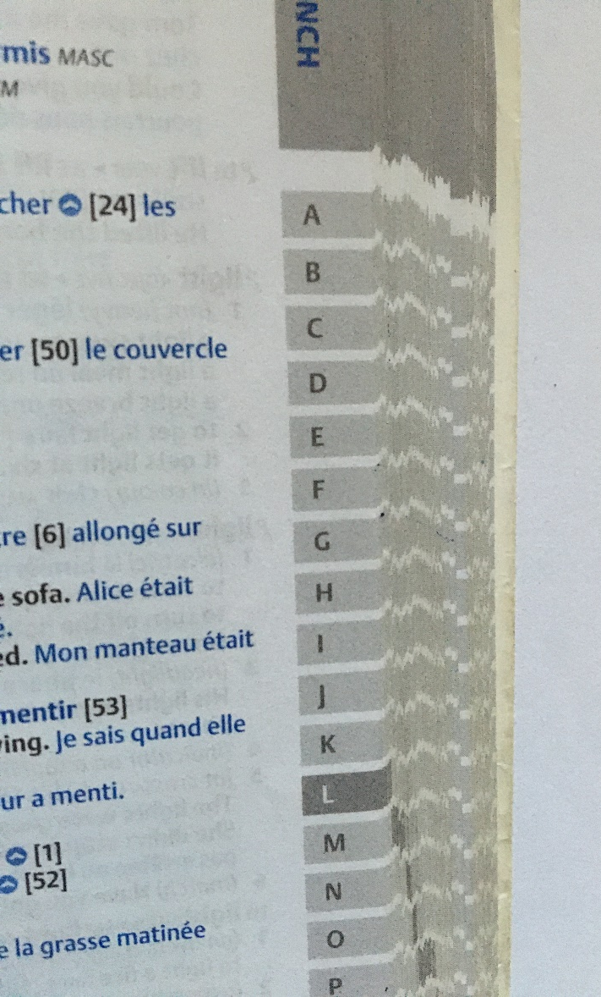
to listen
Which half of the dictionary will we go to?
What letter will we look it up in?

Slide 10
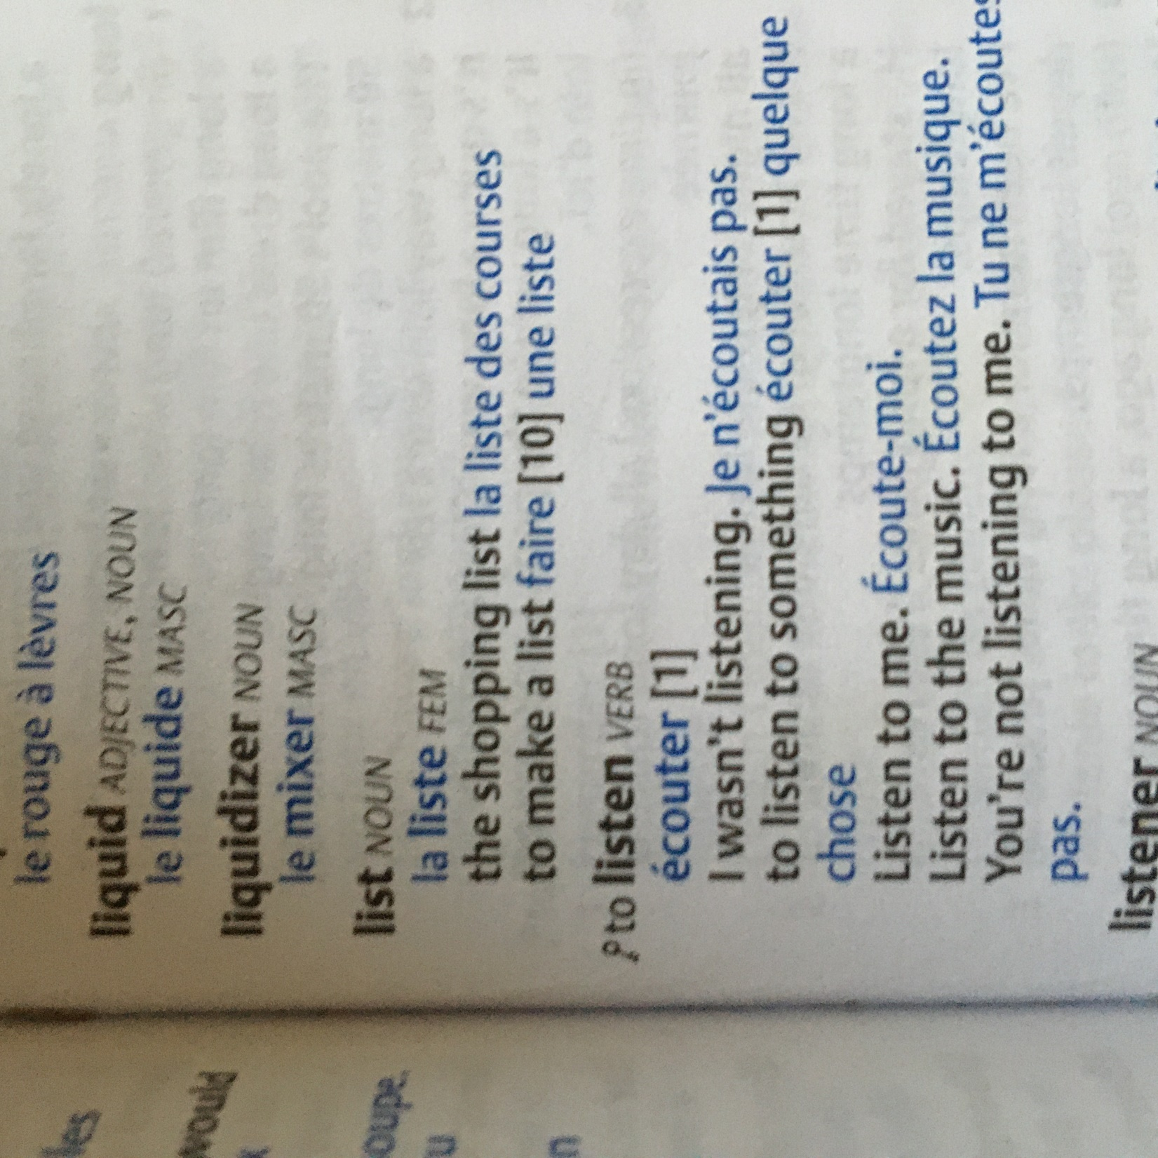

Slide 11
If you have a dictionary, look up the following verbs:
to eat
to watch
to enter
to talk
to draw
to repeat
to wash
to buy
to send
to close
Notes:
If you haven’t keep watching and make notes – or type them into an online dictionary

Slide 12
If you have a dictionary, look up the following verbs:
to eat
to watch
to enter
to talk
to draw
to repeat
to wash
to buy
to send
to close
If you don’t have a paper dictionary, you could use the following on-line dictionary:
https://www.wordreference.com/
Notes:
If you haven’t keep watching and make notes – or type them into an online dictionary

Slide 13
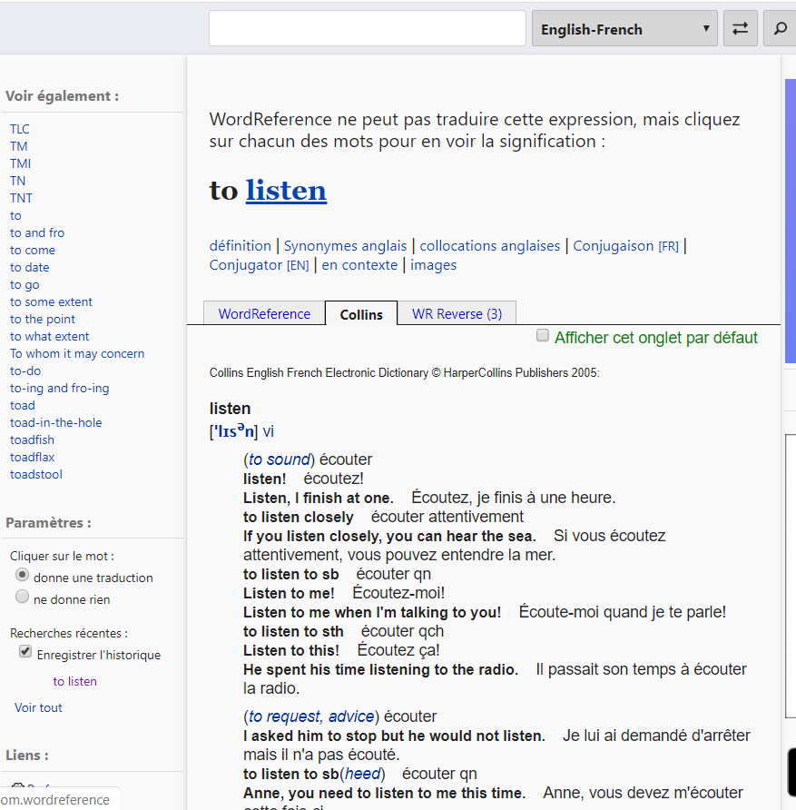

Slide 14
If you have a dictionary, look up the following verbs:
to eat
to watch
to enter
to talk
to draw
to repeat
to wash
to buy
to send
to close
manger
regarder
What do you notice?
Remember if it doesn’t end in ‘-er’ it’s probably not right.
Look again!

Slide 15
If you have a dictionary, look up the following verbs:
to eat
to watch
to enter
to talk
to draw
to repeat
to wash
to buy
to send
to close
manger
regarder
entrer
parler
dessiner
répéter
laver
acheter
envoyer
fermer
Notes:
Go through the answers and mark them – what do you notice? What is really important to remember and learn about verbs in French?

Slide 16
What have we learnt about verbs in French?
They end in ‘-er’
The ending is really important!

Slide 17
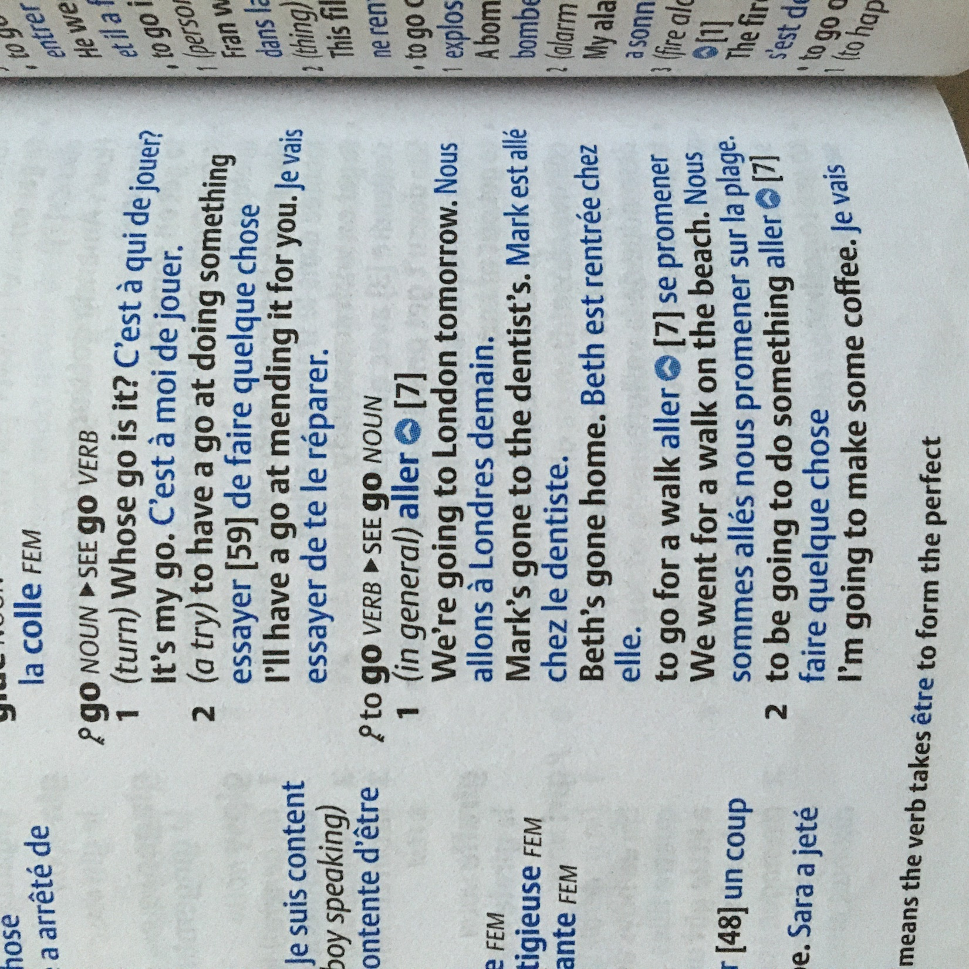
What about these?
to finish
to run
to open
to go out (not go)
to leave
to sleep
to lie (not tell the truth)
to offer
to come

Slide 18
What about these?
to finish
to run
to open
to go out (not go)
to leave
to sleep
to lie (not tell the truth)
to offer
to come

Slide 19
What about these?
to finish
to run
to open
to go out (not go)
to leave
to sleep
to lie (not tell the truth)
to offer
to come

Slide 20
What about these?
to finish
to run
to open
to go out (not go)
to leave (to part)
to sleep
to lie (not tell the truth)
to offer
to come
finir
courir
ouvrir
sortir
partir
dormir
mentir
offrir
venir

Slide 21
What do we now know about verbs in French now?
They end in ‘-er’
They end in ‘-ir’
The ending is really important!

Slide 22
And these?
to sell
to wait
to put
to beat
to sew
to write
to (be) born
to paint
to take
to follow

Slide 23
And these?
to sell
to wait
to put
to beat
to sew
to write
to (be) born
to paint
to take
to follow
vendre
attendre
mettre
battre
coudre
écrire
naître
peindre
prendre
suivre

Slide 24
What do we now know about verbs in French now?
They end in ‘-er’
They end in ‘-ir’
They end in ‘-re’
The ending is really important!

Slide 25
Have a go at using the verbs in a sentence?
I like to sell.
I like to beat.
I like to wash.
I like to repeat.
I like to finish.
J’aime…

Slide 26
Have a go at using the verbs in a sentence?
I like to sell.
I like to beat.
I like to wash.
I like to repeat.
I like to finish.
J’aime vendre

Slide 27
Have a go at using the verbs in a sentence?
I like to sell.
I like to beat.
I like to wash.
I like to repeat.
I like to finish.
J’aime vendre
J’aime battre
J’aime laver
J’aime répéter
J’aime finir

Slide 28
Have a go at using the verbs in a sentence?
I like to sell.
I like to beat.
I like to wash.
I like to repeat.
I like to think.
Feel free to have a go at some more if you feel confident and send them to me to have a look at

Slide 29
What do we know / learn / remember about verbs in French?
They end in either ‘-er’
They end in or ‘-ir’
They end in or ‘-re’
The ending is really important!
When they end like this they are called the ‘infinitive’
This is how they are in the dictionary.

