Slide 1
lundi, vingt avril
L’Objectif:
nommer les activités (les verbes)
analyser les verbes

Slide 2

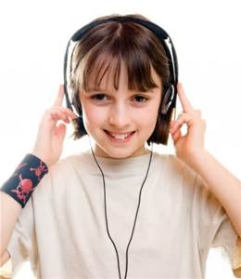
Notes:
écouter – use mimes to demonstrate the meaning.

Slide 3
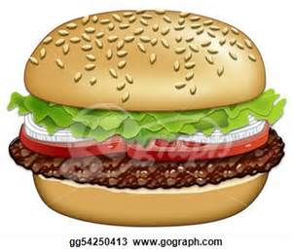
Notes:
manger

Slide 4
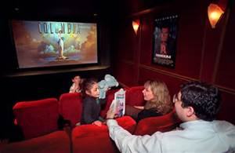
Notes:
regarder

Slide 5
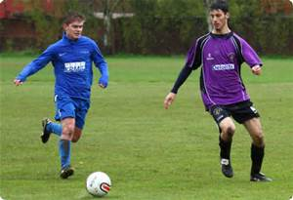
Notes:
jouer

Slide 6
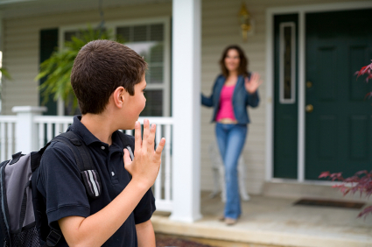
Notes:
quitter

Slide 7
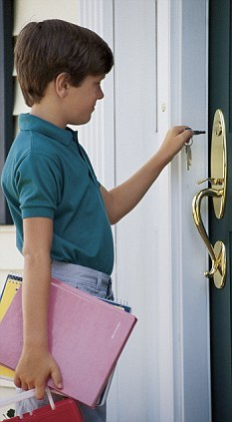
Notes:
arriver

Slide 8
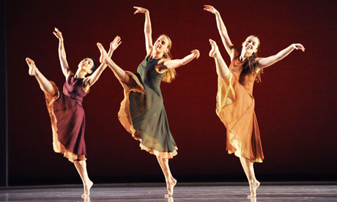
Notes:
danser

Slide 9
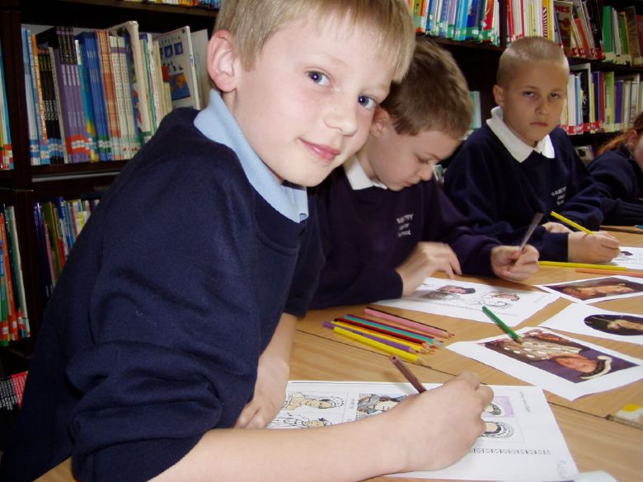
Notes:
travailler

Slide 10
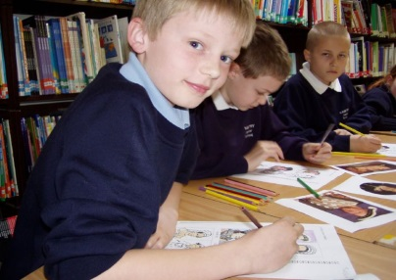
1.
2.
3.
4.
5.
6.
7.
8.
Notes:
Give them time to see if they can note the French for each of the pictures.

Slide 11
Notes:
Use to get them to learn and name the activities: start with the listening and move on to the speaking. Use mimes to help them.

Slide 12
Notes:
Say which one is missing – French

Slide 20
1.
2.
3.
4.
5.
6.
7.
8.
Notes:
Give them time to see if they can note the French for each of the pictures.

Slide 21
1.
2.
3.
4.
5.
6.
7.
8.
travailler
quitter
écouter
arriver
manger
regarder
jouer
danser
Notes:
Give them time to see if they can note the French for each of the pictures.

Slide 22
écouter
manger
regarder
jouer
quitter
danser
travailler
arriver
Notes:
Check their work against the answers.

Slide 23
What do you notice about each of the verbs?
écouter
manger
regarder
jouer
quitter
arriver
danser
travailler
Notes:
Discuss in pairs and then share ideas. Then write in exercise books what we have found out about verbs in French.

Slide 24
Notes:
Memory retrieval – test each other: pairs and whole class.

