Slide 1




#OnlineSafetyAtHome
From Thinkuknow
Social media support pack

Slide 2
About #OnlineSafetyAtHome
#OnlineSafetyAtHome has been created by the NCA-CEOP Thinkuknow Education Team to support parents and carers during COVID-19 and the closure of schools.
Each fortnight, we release new home activity packs with simple 15 minute activities parents and carers can do with their child to support their online safety at home.
Today (21st April) we launch our third set of activities, with the first two releases having a combined download total over 100,000.
This pack will provide you with the content and assets you will need to share #OnlineSafetyAtHome with the families you work with. Thank you for your continued support.

Slide 3

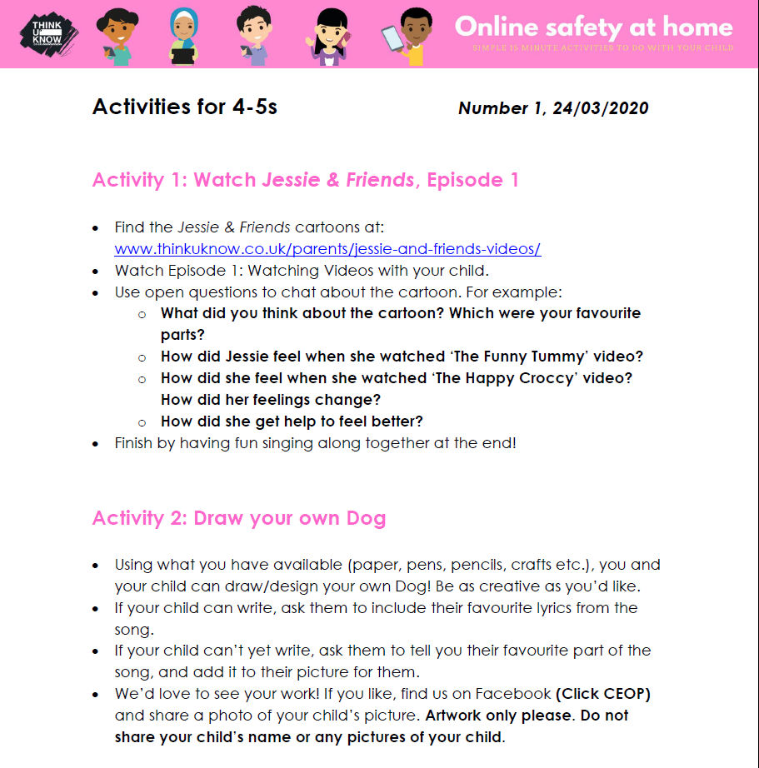
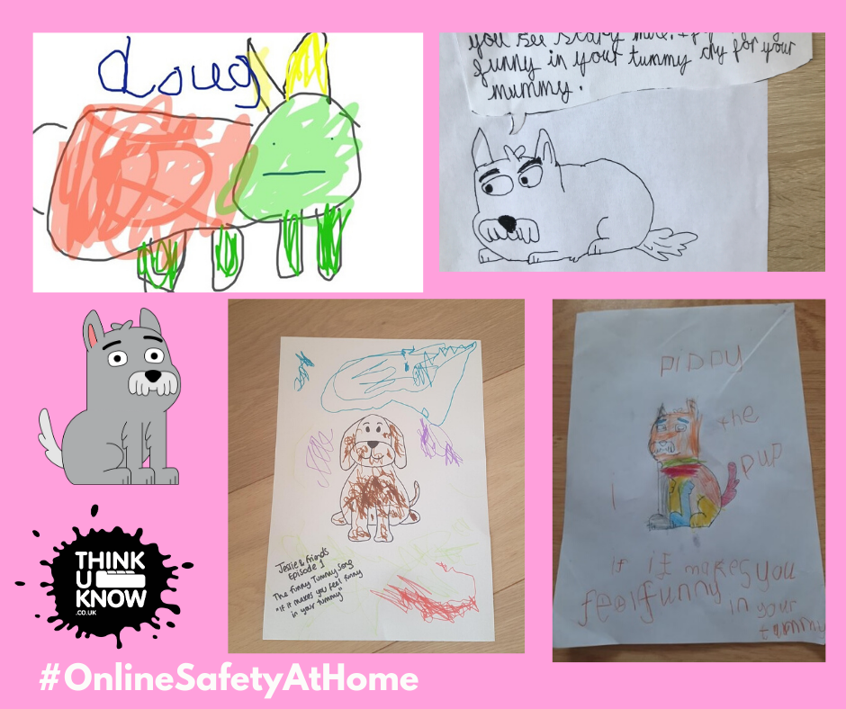
Example activity pack – Primary age

Slide 4
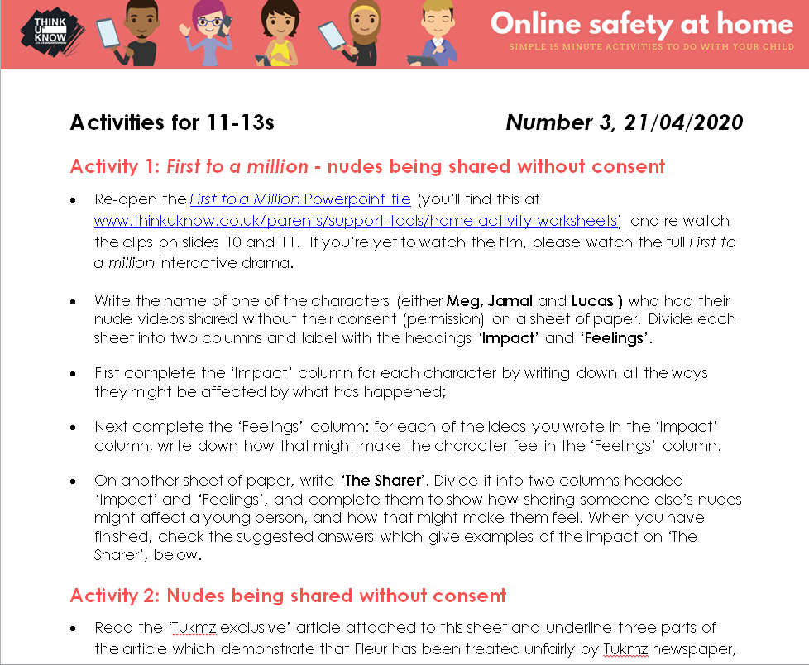
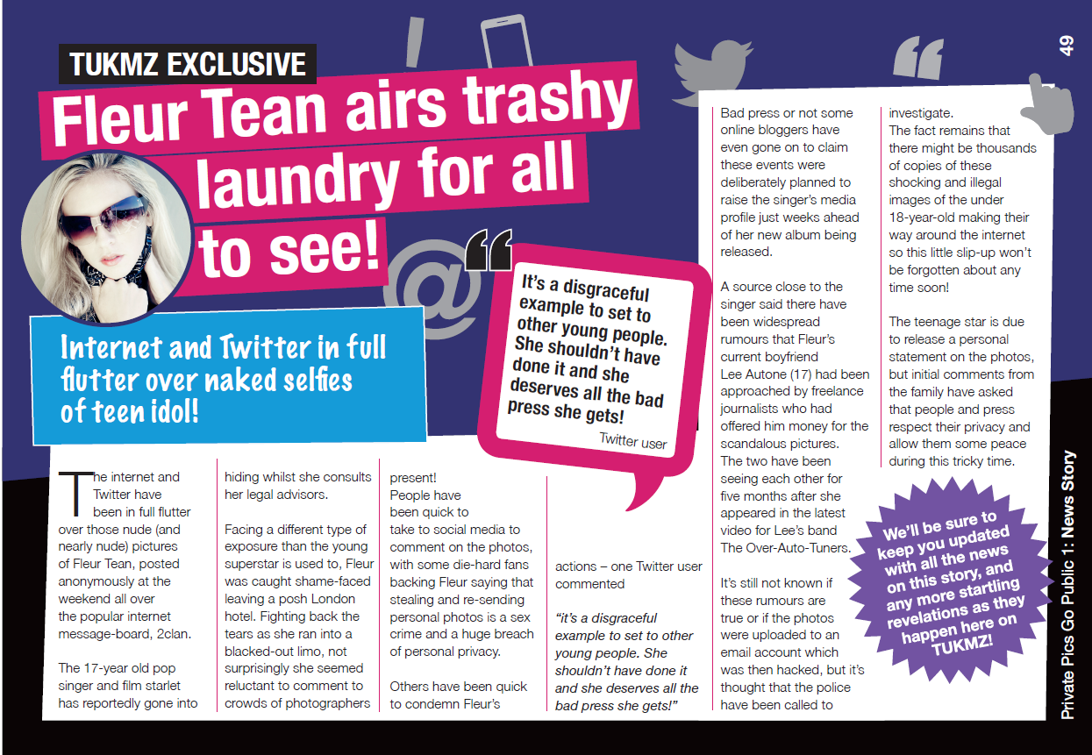
Example activity pack – Secondary age

Slide 5




Parents and Carers Helpsheets
In addition to the activities, we have created Parents and Carers Helpsheets with key online safety advice and links to our resources, as well as different support services.
You can find these here.

Slide 6
To help us to shape our offer and better meet your needs, please complete our short survey. It should take no more than 5 minutes to complete.
Parents survey
To help us shape the #OnlineSafetyAtHome package, we are asking parents and carers to complete our short survey. It should take no more than 5 minutes to complete. Please ask the parents and carers you work with take part, the survey can be found here.

Slide 7
To help us to shape our offer and better meet your needs, please complete our short survey. It should take no more than 5 minutes to complete.
Professionals survey
To help us shape the #OnlineSafetyAtHome package, we are asking professionals to complete and share our short survey. It should take no more than 5 minutes to complete. You can find the survey here.

Slide 8
4 Key messages for Parents and Carers
Where possible, please use the following key messages to support the families you work with:
Use this as an opportunity to talk to your child about their use of the internet
With children and parents spending more time at home, now is a great time to continue to chat with your child about how they are using online technology and what it means to them. Their use of apps and games may have changed since the outbreak, so now is a good time to check in!
2. Explore Thinkuknow resources using the #OnlineSafetyAtHome activity packs
Every fortnight Thinkuknow will release a new set of #OnlineSafetyAtHome activity packs to share with children between the ages of 3 and 16. Use these to help you keep up a positive, supportive conversation about safety online in your home

Slide 9
4 Key messages for Parents and Carers - continued
3. Tell your children to report anything that worries them
It’s important that children and young people always know where to go if they come across something that worries them or makes them feel uncomfortable online. Remind them regularly that you’re there to help.
4. Use parental controls
Setting parental controls can be a quick and effective tool to help protect your children online, and should be installed on all devices that children use.
More information is available here.

Slide 10
Suggested social media posts for activities
Facebook
‘Technology can provide hours of education and important social opportunities for children whilst schools are closed, it can also present a number of risks. Here are 4 things you can do to support your child online during this unsettling time’ - Link to parents article – www.thinkuknow.co.uk/parents/support-tools/support-your-child-at-home
Are you looking for simple online safety activities to do with your child at home? You can find home activity packs and more information and guidance on the Thinkuknow parent/carers website www.thinkuknow.co.uk/parents/Support-tools/home-activity-worksheets
Every fortnight @ClickCEOP are sharing new #OnlineSafetyAtHome activity packs for primary and secondary age children on their parents/carers site. For fun, age-appropriate activities you can do with your child to help keep them safe online whilst they are off school, download the most recent packs here www.thinkuknow.co.uk/parents/Support-tools/home-activity-worksheets

Slide 11
Suggested social media posts for activities
Facebook
Have you downloaded @ClickCEOP`s 15-minute home activity packs for children aged 4-7? They`ve created simple, fun activities for early years and primary school aged children to help learn #OnlineSafetyAtHome. Download the first activity packs here www.thinkuknow.co.uk/parents/Support-tools/home-activity-worksheets
Download your first home activity pack for children aged 8-10. Each pack contains simple 15-minute activities you can do at home with your child to help them learn #OnlineSafetyAtHome. Download your first pack here www.thinkuknow.co.uk/parents/Support-tools/home-activity-worksheets
@ClickCEOP has created simple, 15 minute activity packs for secondary aged children to help them learn #OnlineSafetyAtHome if their school is closed. New packs will be available every fortnight. Have you got your first pack yet? Download it here www.thinkuknow.co.uk/parents/Support-tools/home-activity-worksheets

Slide 12
Suggested social media posts for activities
Twitter
Are you a parent/carer looking for information on how to help keep your child safe online? Read @CEOPUK advice on things you can do to support your child’s safety online during this uncertain time’ - Link to parents article – www.thinkuknow.co.uk/parents/support-tools/support-your-child-at-home
Are you a parent at home with your children during the COVI D -19 outbreak? @CEOPUK has launched the #OnlineSafetyAtHome campaign where they will be providing you with simple 15 minute activities to help you support your children over the coming weeks and months. Download your first packs here www.thinkuknow.co.uk/parents/Support-tools/home-activity-worksheets
@CEOPUK has created new #OnlineSafetyAtHome activity packs to help you support children and families over the coming weeks and months. Each pack contains simple 15-minute activities for children age 4-16 to do at home using their Thinkuknow resources. Download your first activity packs here www.thinkuknow.co.uk/parents/Support-tools/home-activity-worksheets

Slide 13
Suggested social media posts for activities
Twitter continued
Have you downloaded @CEOPUK‘s 15-minute home activity packs for children aged 4-7? They have created simple, fun activities for early years and primary school aged children to help them learn #OnlineSafetyAtHome. Download the first activity packs here and share with parents and carers www.thinkuknow.co.uk/parents/Support-tools/home-activity-worksheets
Download your first home activity pack for children aged 8-10. Each pack contains simple 15-minute activities you can do at home with your child to help them learn #OnlineSafetyAtHome . Download your first pack here and share with the parents and carers you know. www.thinkuknow.co.uk/parents/Support-tools/home-activity-worksheets
@CEOPUK has created simple, 15 minute activity packs for secondary aged children to help them learn #OnlineSafetyAtHome whilst off school. New packs will be available every fortnight. Have you got your first pack yet? Download it here and share with parents and carers www.thinkuknow.co.uk/parents/Support-tools/home-activity-worksheets

Slide 14

Suggested social media posts for CEOP Reporting
Work with children and young people? Embed the ClickCEOP button in your organisation’s website to provide them with a direct route to report online sexual abuse if they feel they do not have a trusted adult to go to. Follow the link for more information on how to embed the button www.thinkuknow.co.uk/professionals/click-ceop-button
Remember if something has happened online that to your child that has made them feel unsafe, scared or worried, you can report directly to CEOP following the link below. If you are worried that a child is in immediate danger, please call 999
https://www.ceop.police.uk/Safety-Centre/
Should-I-make-a-report-to-CEOP-YP/
Should-I-make-a-report-to-CEOP-parent/
“Work with children and young people? Embed the ClickCEOP button in your organisation’s website to provide them with a direct route to report online sexual abuse if they feel they do not have a trusted adult to go to. Follow the link for more information and to embed the button www.thinkuknow.co.uk/professionals/click-ceop-button

Slide 15
Parent Info
Parent Info is a collaboration between Parent Zone and NCA-CEOP, providing support and guidance for parents and carers related to the digital world from leading experts and organisations.
Specific articles have been created for Parent Info to support families during this difficult time.
Here’s a few examples:
Coronavirus – how to help children spot fake news
How to look after your family’s mental health when your stuck indoors
Quarantined: helping teenagers cope with lockdown
In addition to supporting NCA –CEOP promote the #OnlineSafetyAtHome, we ask that as a professional you register and promote the Parent Info articles to parents and carers.

Slide 16

Parent Info suggested posts
Parent Info is a valuable source of information bought to you by @ClickCEOP (Facebook)/@CEOPUK (Twitter) and @ParentZone1 (Facebook)/@TheParentsZone (Twitter). Check out their articles to support your family during this lock down period – www.parentinfo.org
It can be difficult to keep your family’s spirits up when cooped up inside. This Parent Info article shares some helpful ideas to look after your family’s mental health as we all self-isolate. Read and share the article here https://parentinfo.org/article/how-to-look-after-your-family-s-mental-health-when-you-re-stuck-indoors
Social distancing and self-isolation brings challenges for everyone. But teens face a particularly hard time. Read and share this Parent Info article for advice on helping teenagers cope with lockdown
https://parentzone.org.uk/article/quaranteened-helping-teenagers-cope-lockdown

Slide 17
Assets available for download*
The assets on the following slides can all be downloaded from: www.thinkuknow.co.uk/professionals/ourviews/onlinesafetyathome-resources
Notes:
*The promotional banners and images provided in this pack may only be used to promote NCA-CEOP’s #OnlineSafetyAtHome campaign and resources, and must be accompanied by a link or hyperlink to www.thinkuknow.co.uk/Support-Tools/Home-Activity-Worksheets/, in one or more of the following:
social media posts which raise awareness of Thinkuknow and #OnlineSafetyAtHome
online or print communications with parents/carers and/or professionals regarding Thinukknow and #OnlineSafetyAtHome
web content related to Thinkuknow and #OnlineSafetyAtHome resources

Slide 18
Downloadable Banners/Images*

Slide 19
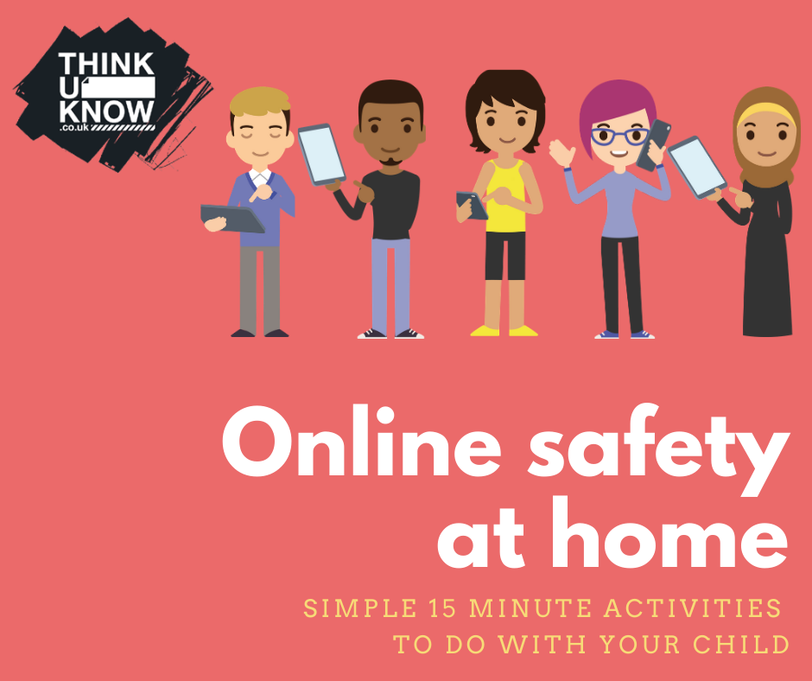
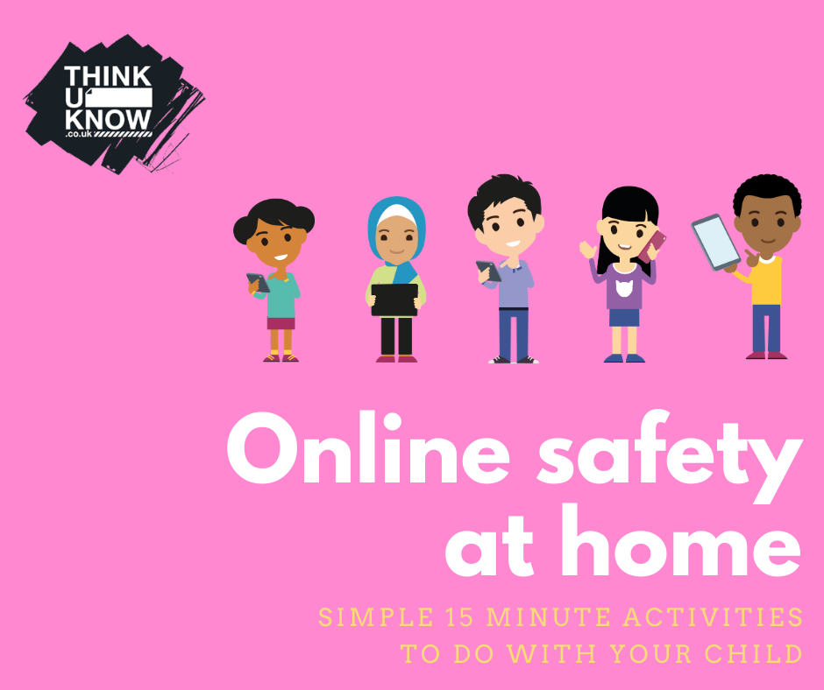

Downloadable Banners/Images*

Slide 20
Downloadable Banners/Images*

Slide 21
Thank you!
Thank you for supporting the #OnlineSafetyAtHome campaign. Please don’t forget to tag us in any social posts and if you have any questions about the campaign, please contact the NCA-CEOP Education Team at ceopeducation@nca.gov.uk

