Slide 1

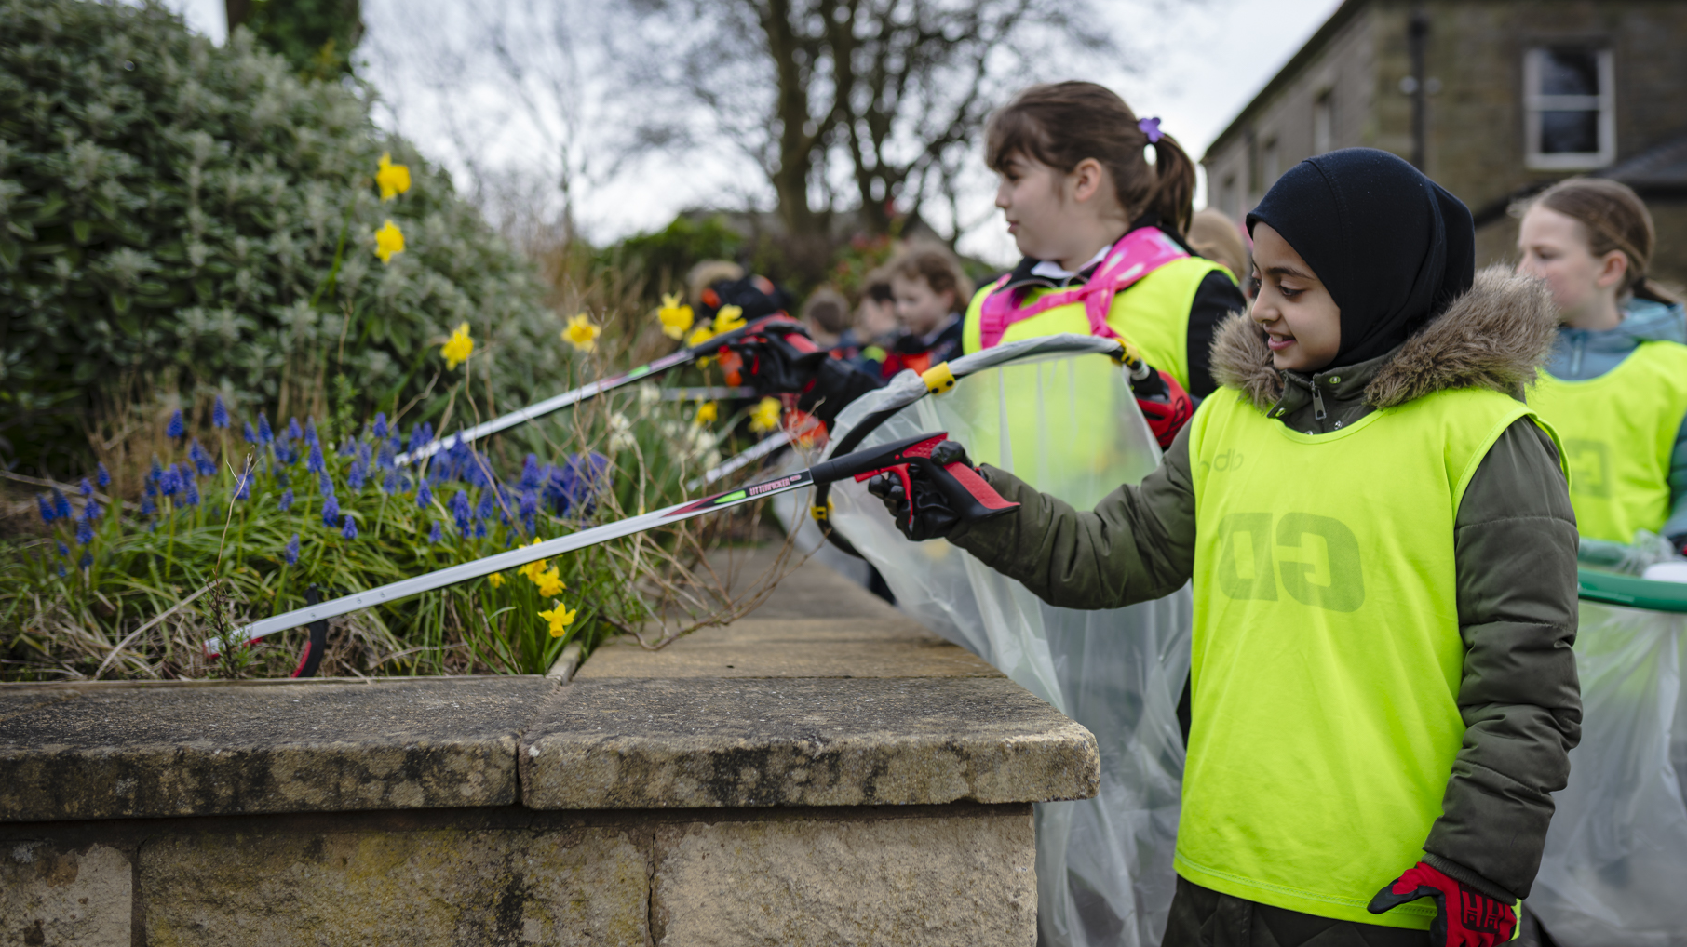



Litter Assembly

Slide 2
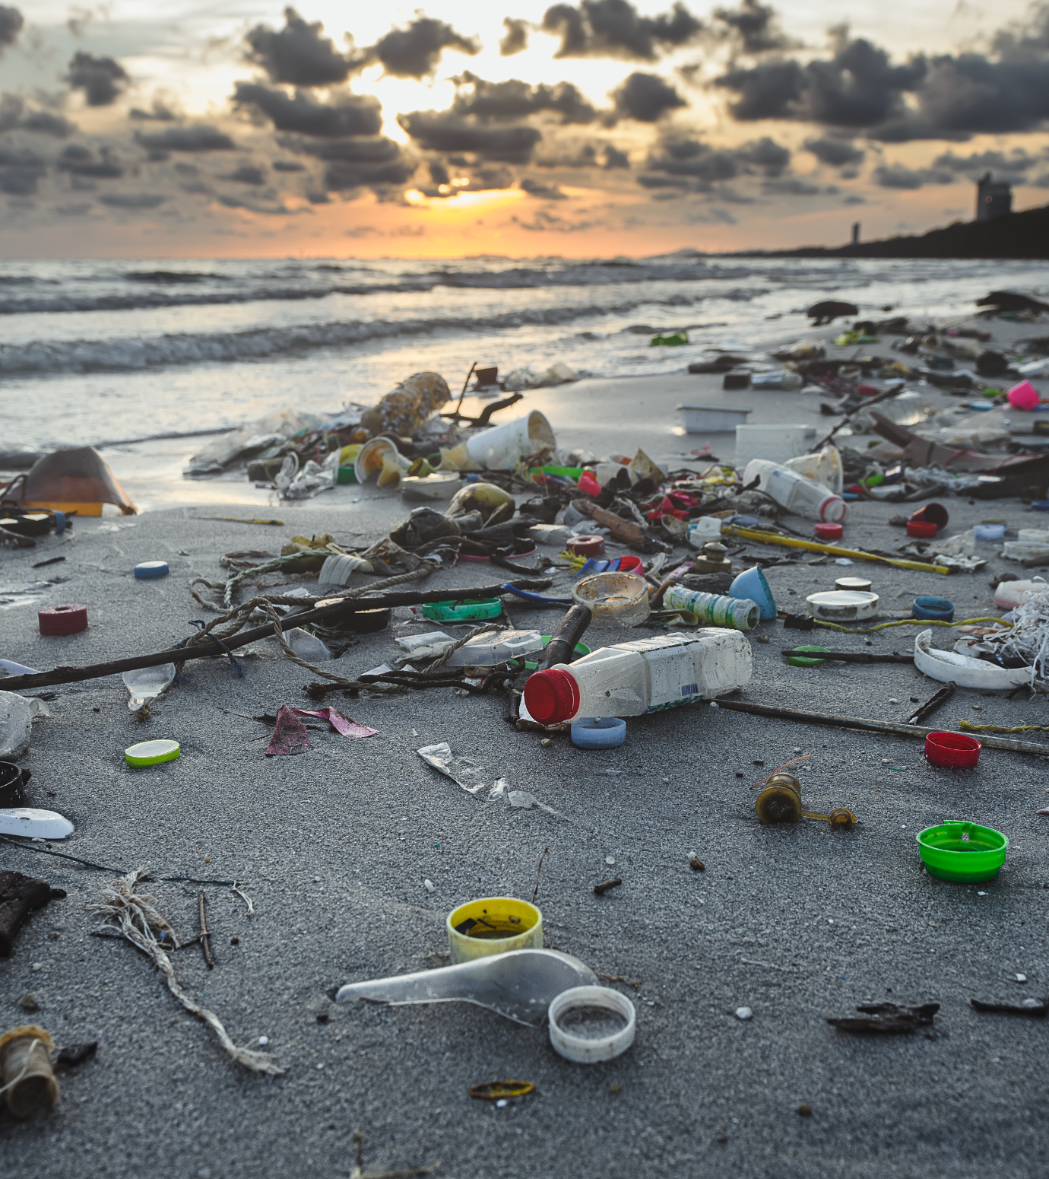

What is Litter?
Click to reveal
Litter is waste, that’s in the wrong place.
In the UK over two million pieces of litter are dropped every day.
What do you think are the most littered items?
Click to reveal

Slide 3
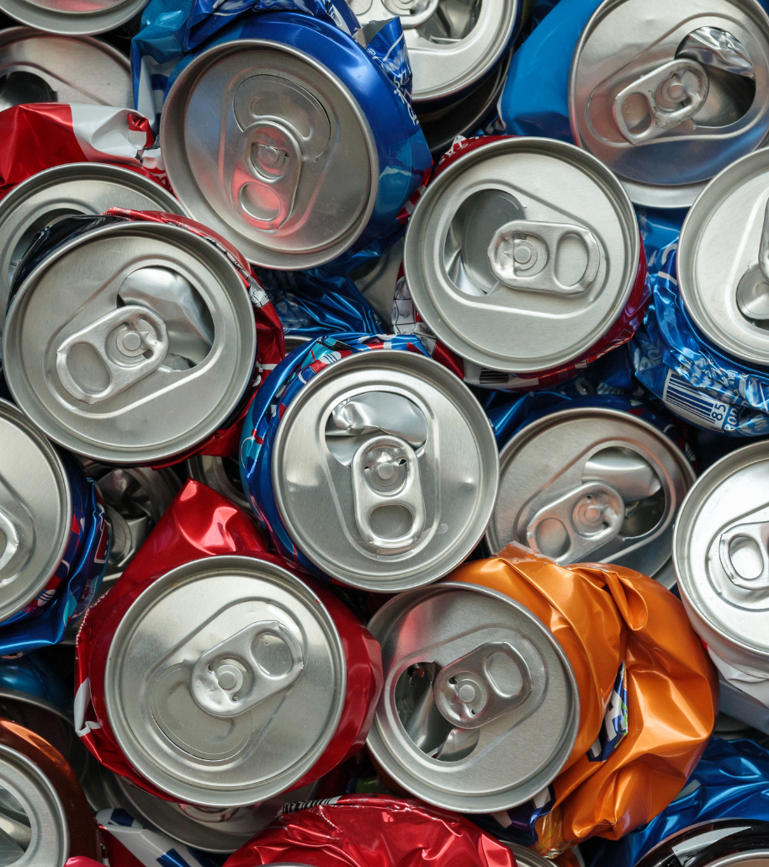
Cigarette butts and vapes
Sweets, chocolate and crisp wrappers
Soft drink bottles and cans
Takeaway and fast-food litter
Alcoholic drinks, bottles and cans
Click to reveal more

Slide 4
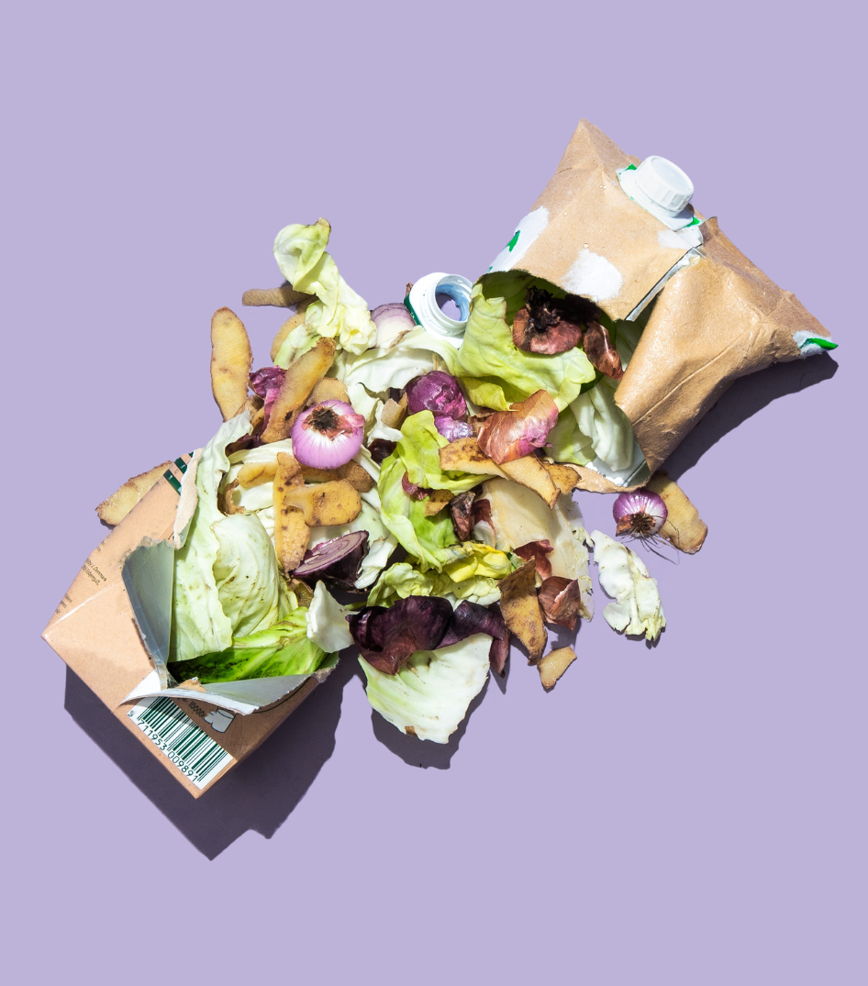
Packaging
Snack packs
Vehicle parts
Discarded food and drink
Clothing

Slide 5
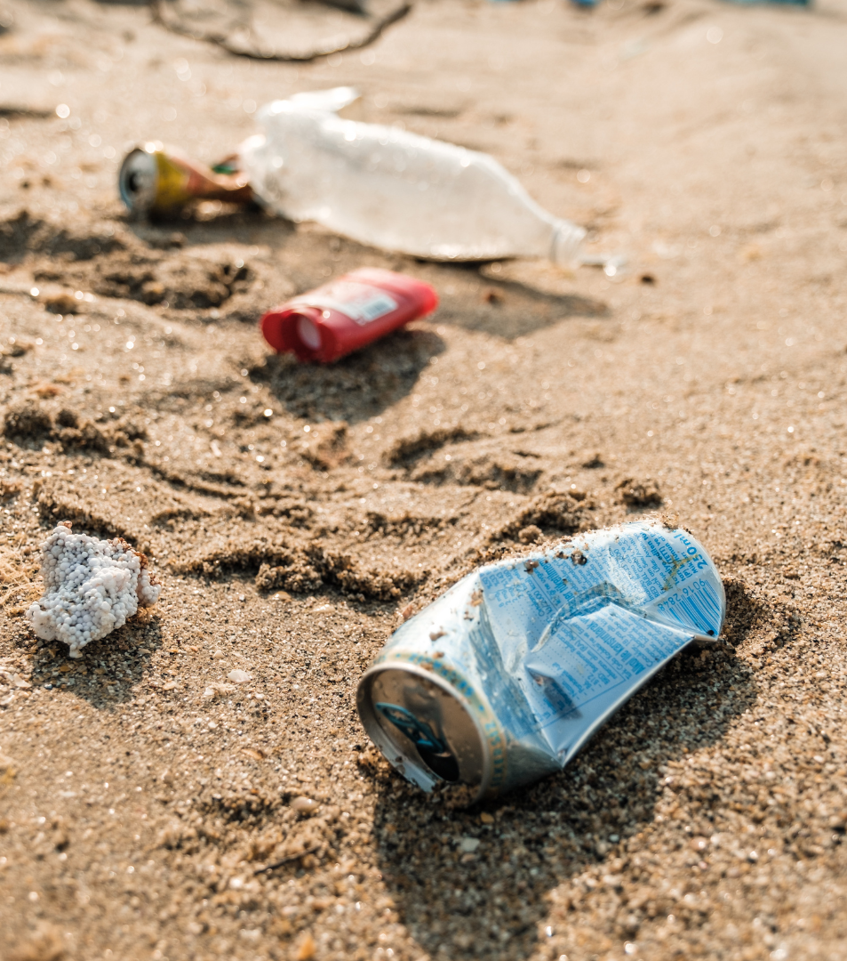
Why do people drop litter?
Click to reveal
Being lazy - when there isn’t a bin nearby, some people don’t want to carry their rubbish, so they just drop it.
Following others - if an area is already messy, or if they see their friends or family littering, they might think it’s ok to do the same.
Continued on next slide

Slide 6
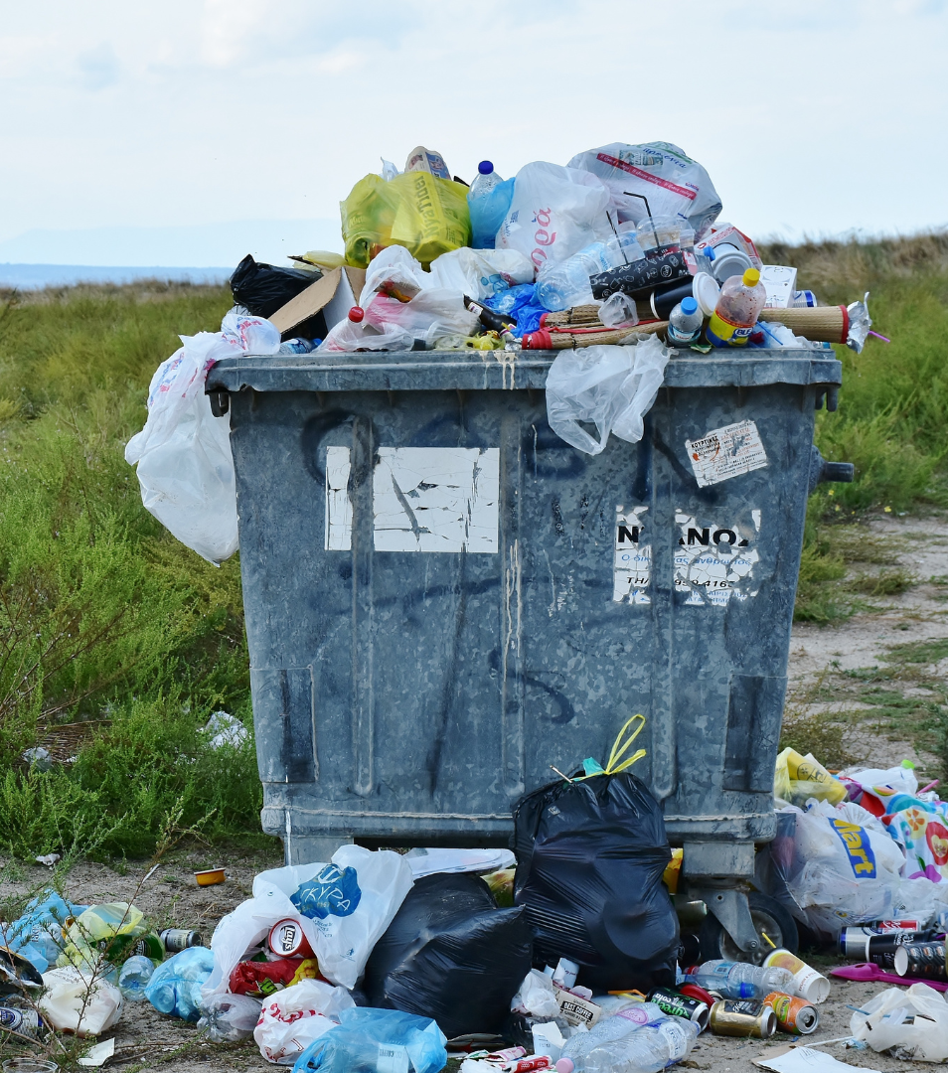
Lack of responsibility - some people feel like it’s not their responsibility to keep public spaces clean.
Lack of environmental awareness - they might not understand how harmful littering can be.

Slide 7
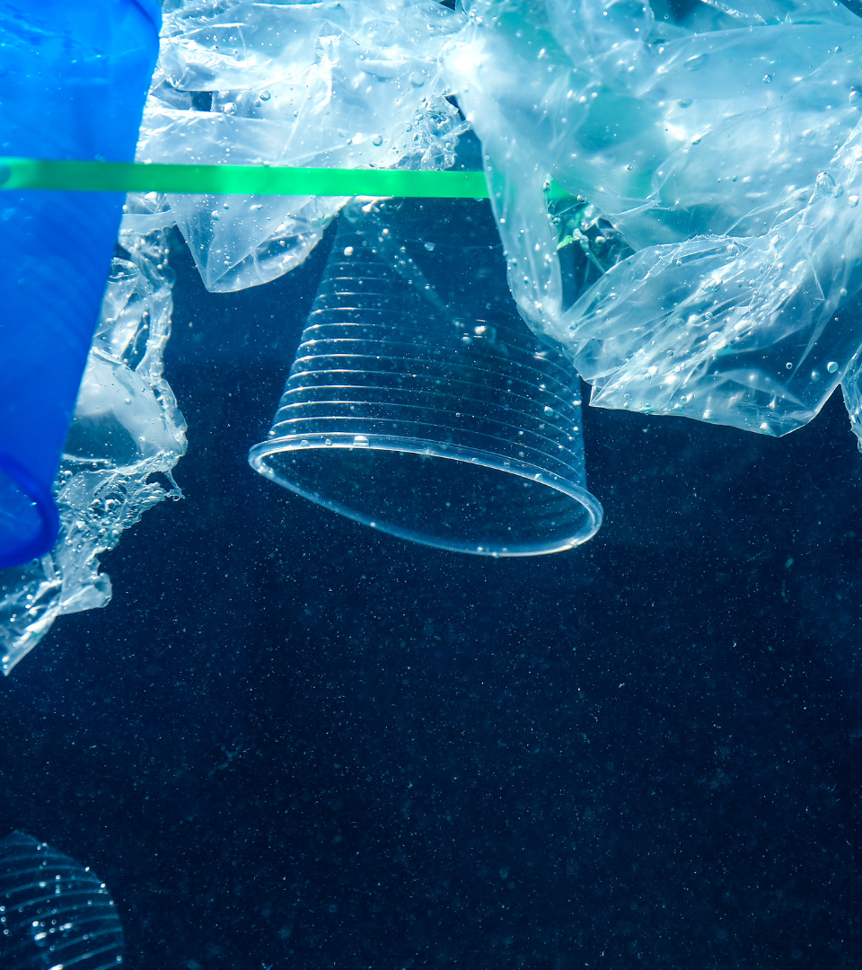
What problems are caused by Litter?
Litter can a devastating impact on communities, nature and even our mental health.
What do you think are some of the problems caused by litter?
Click to reveal

Slide 8
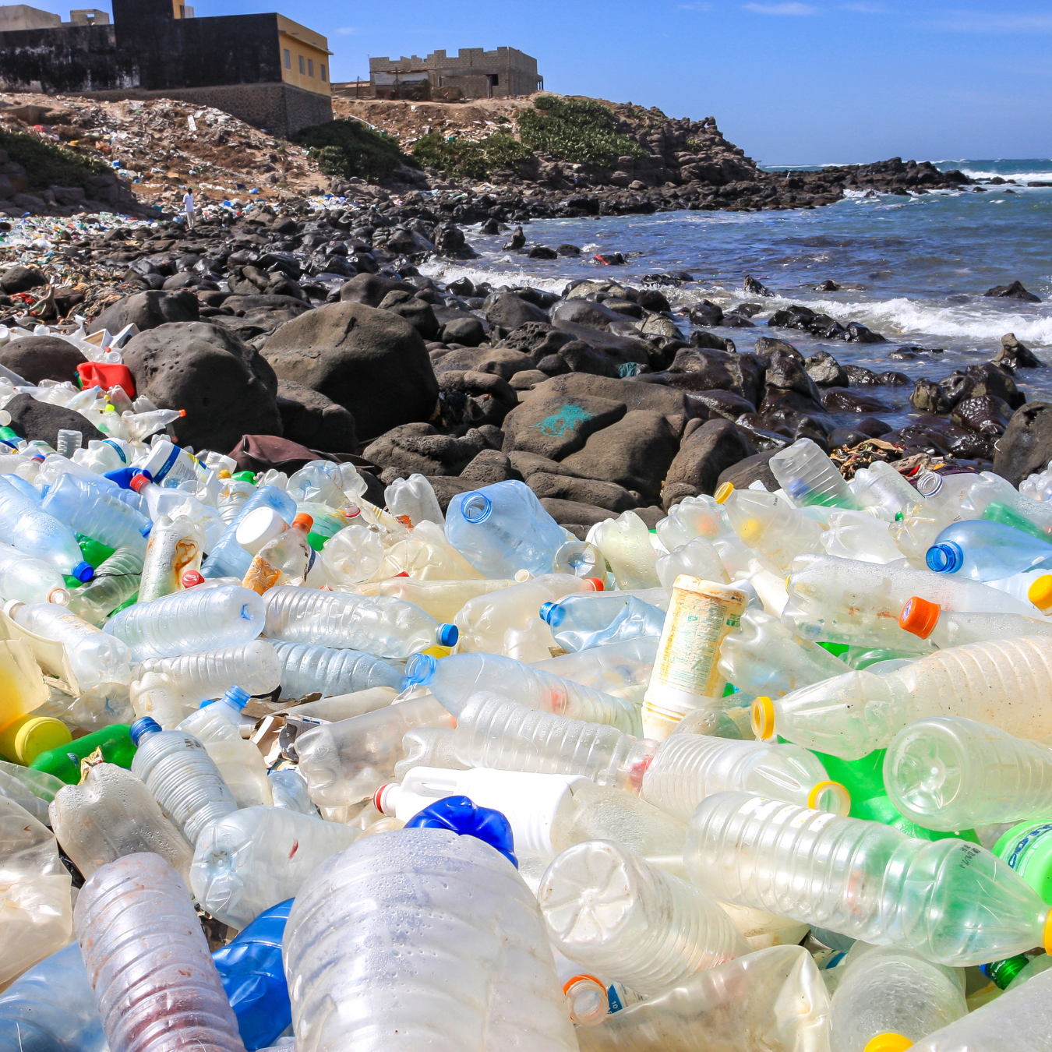
Pollution
Litter can end up in rivers and oceans, polluting marine environments.
Even on land, litter can break down and release harmful chemicals into the soil.

Slide 9
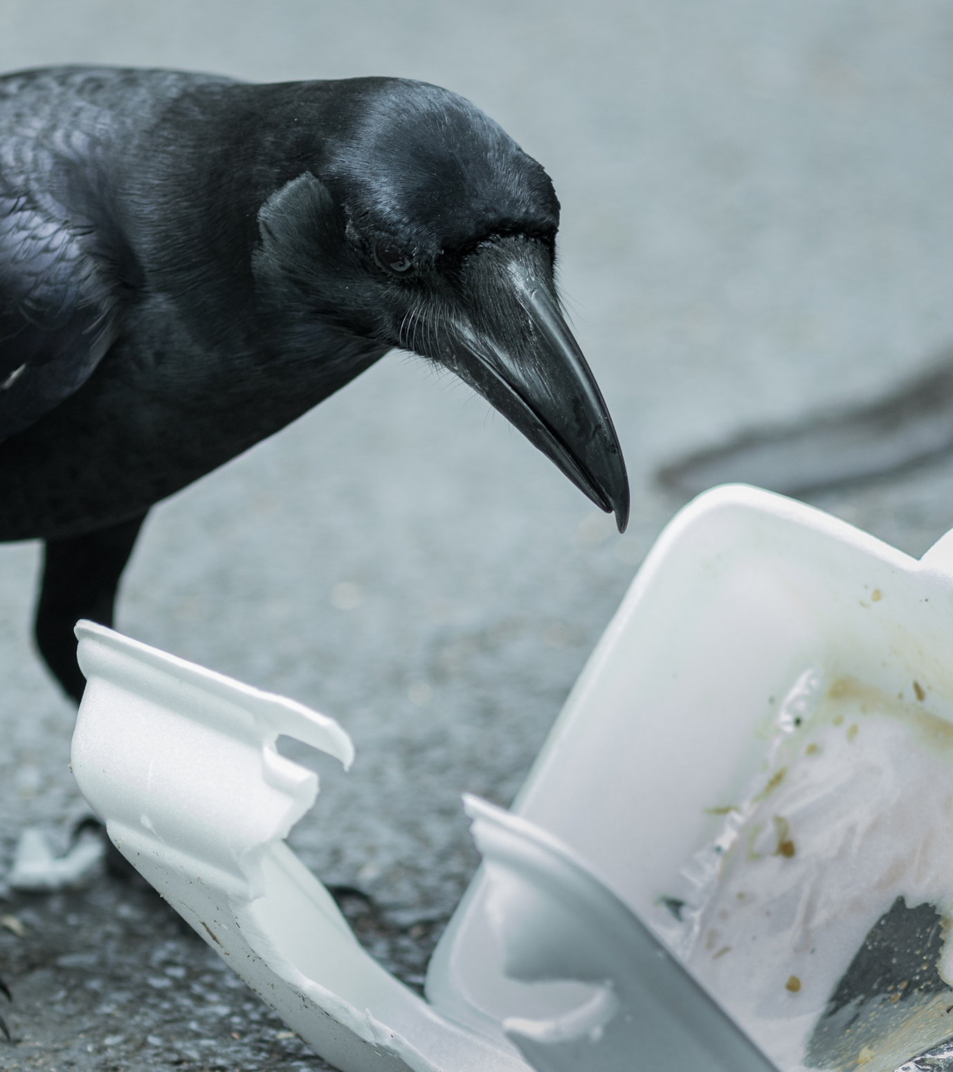
Harming animals
The RSPCA receives ten calls a day about animals harmed by litter.
An animal might eat litter thinking it’s food, enter a used container and get trapped, or cut themselves on sharp objects like cans or glass.

Slide 10
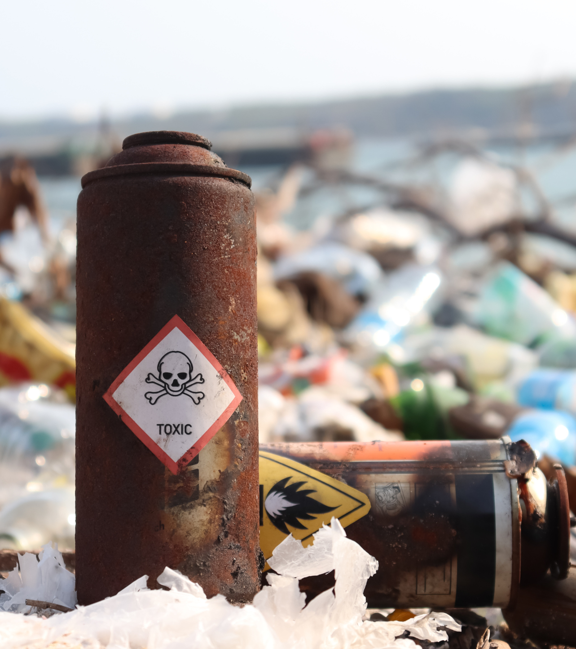
Harming people
Litter can also hurt us.
It can cause accidents like tripping, we can get cuts from sharp objects, or it can attract vermin that spread disease.

Slide 11
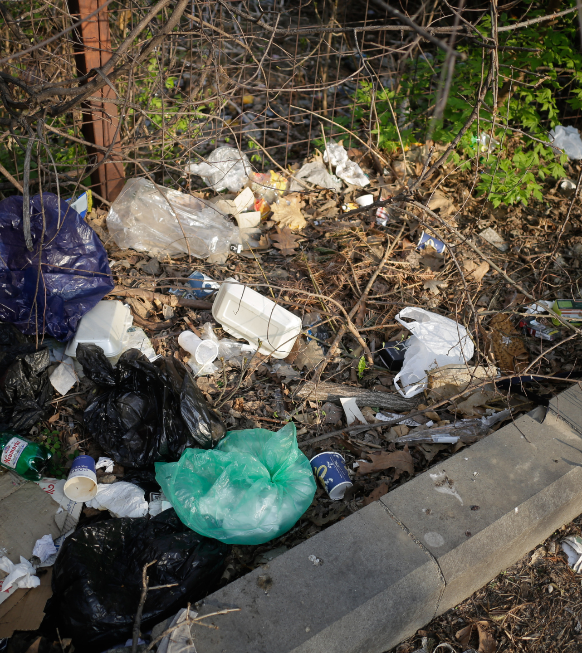
Community problems
Litter can make an area look bad and send a message that anti-social behaviour is OK.
This can make people feel more scared in their local community and even lead to an increase in crime.

Slide 12
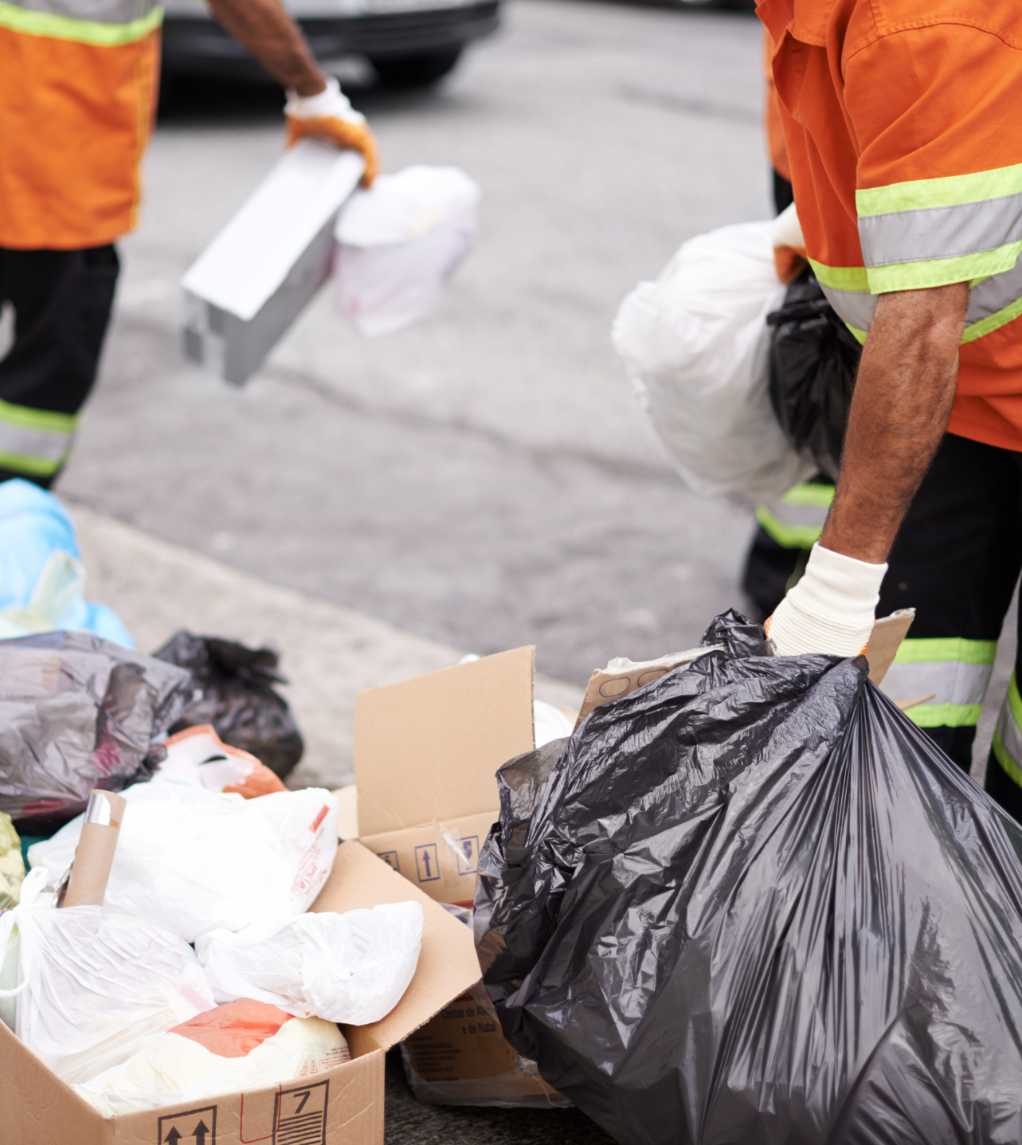
Costly clean-ups
Litter also costs our country a lot of money to clean up – around £1bn every year.
This money could be better-spent on things like green spaces, schools, or the NHS.

Slide 13
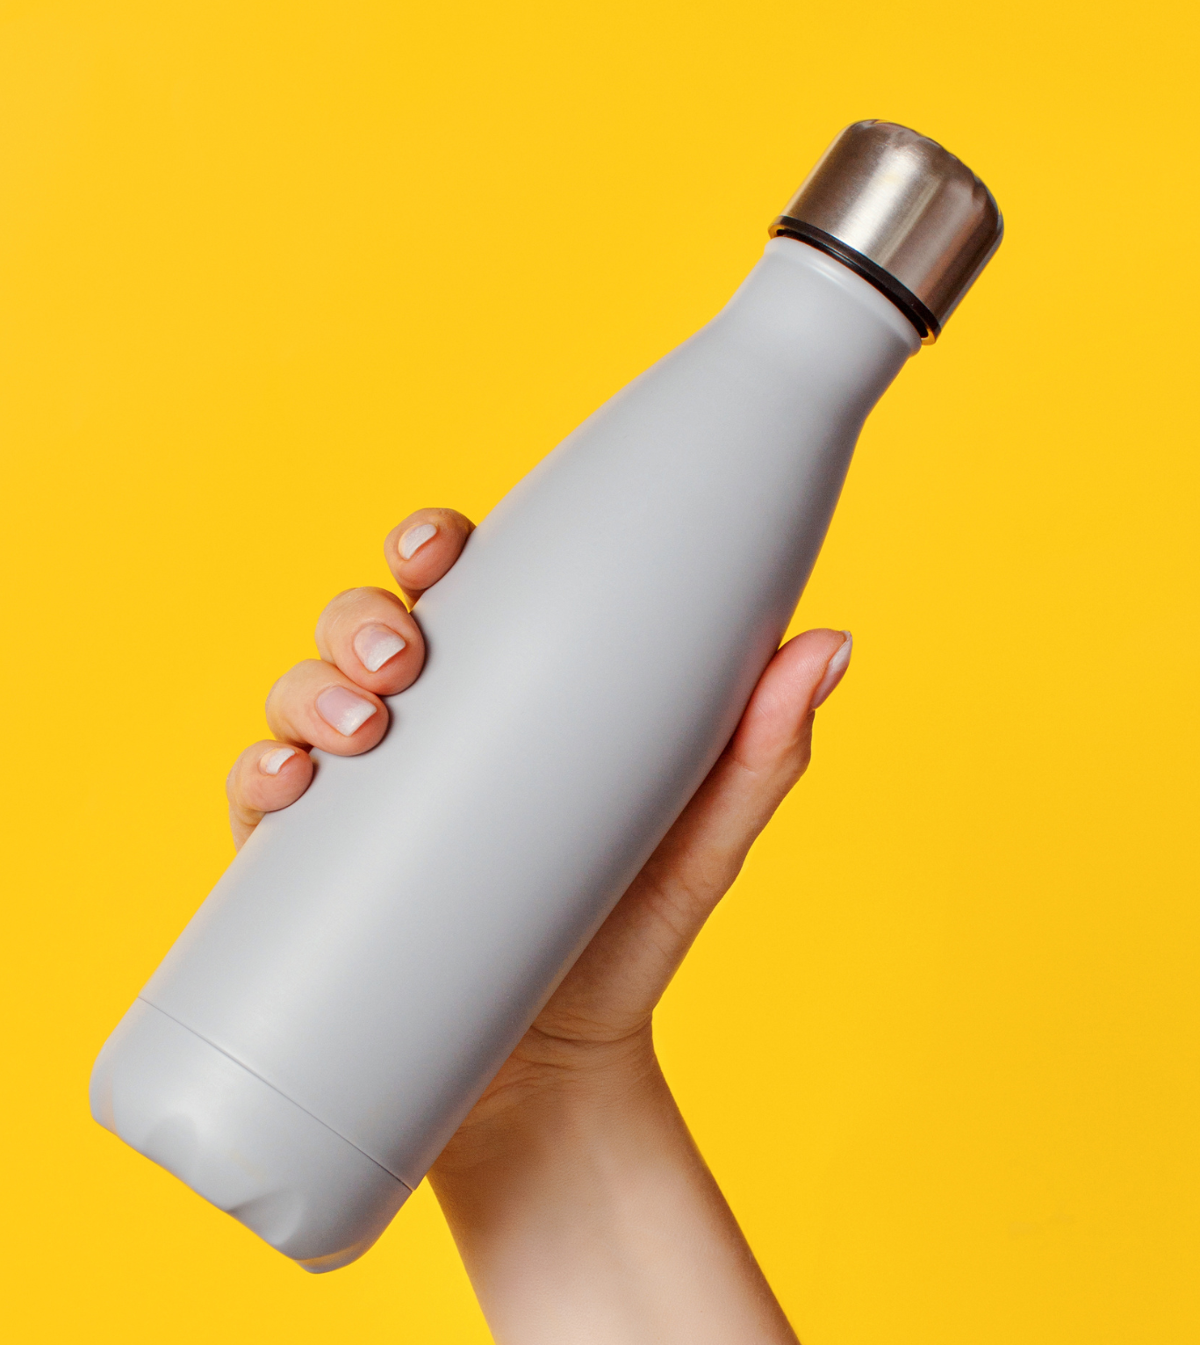
What can we do to reduce Litter?
Click to reveal
Make less litter! The best thing we can do is to simply create less waste in the first place. For example, if you use a reusable bottle or tote bag, you’re not producing any waste that can become litter.
Click to reveal more

Slide 14
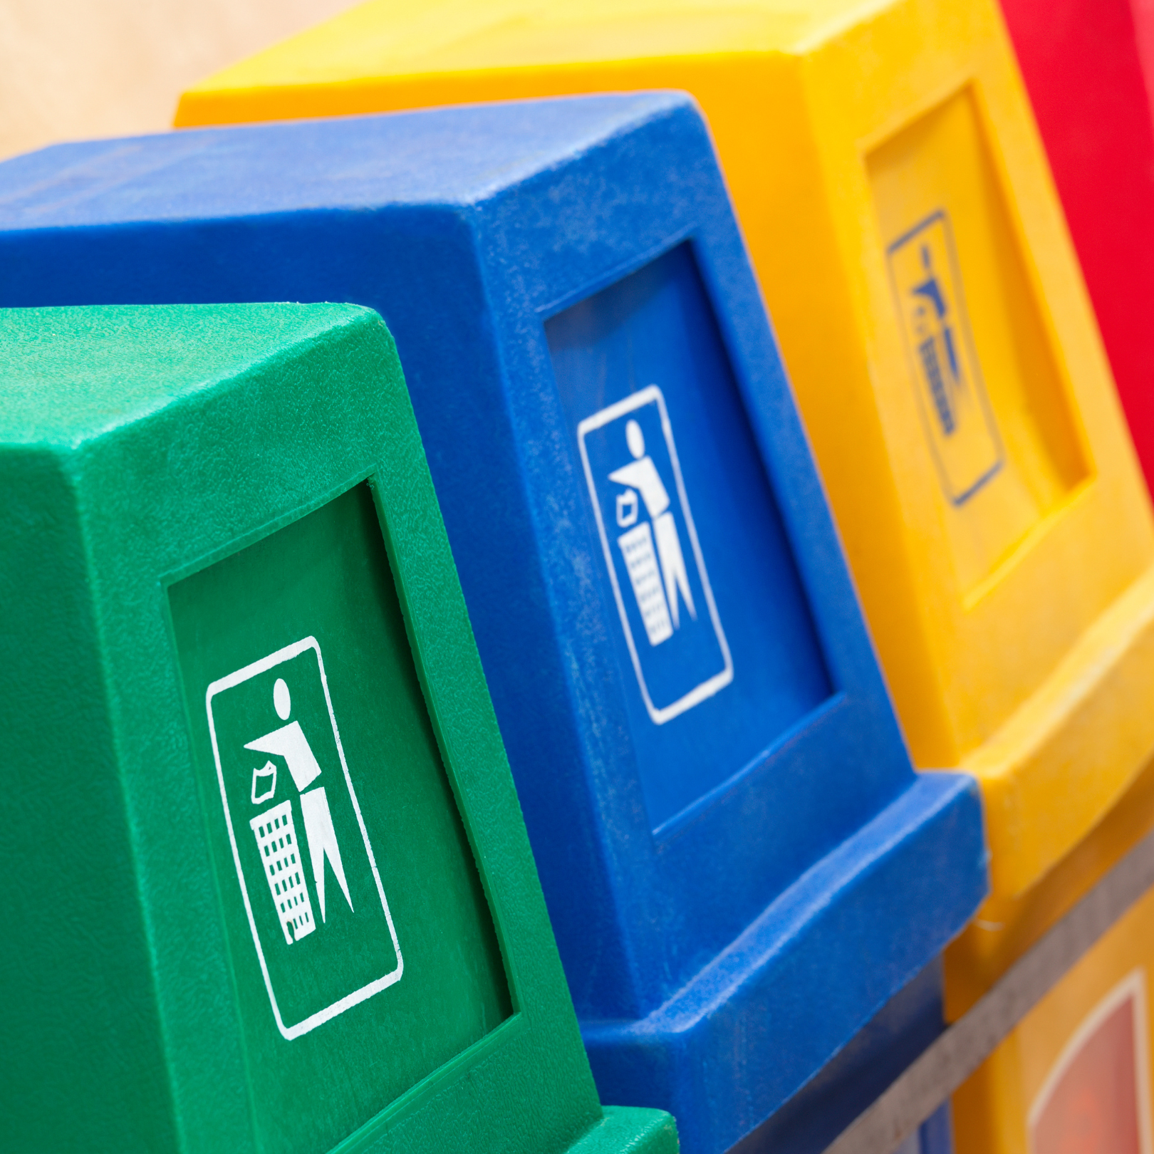
Set a good example. If you have rubbish, recycle it or find a bin. If you see a friend or family member littering, tell them it’s not OK! Leading by example can change bad behaviours.
Litter-pick. Sadly, our country already has a lot of litter around, but we can help by picking it up.

Slide 15
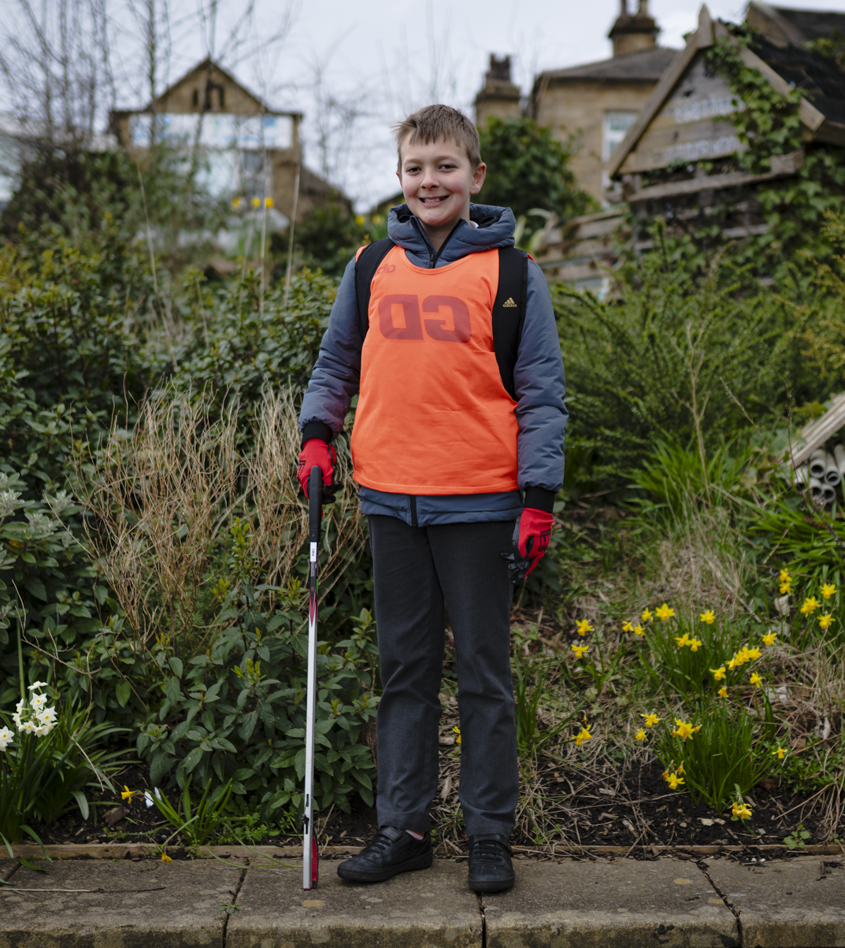
What are the benefits of litter-picking?
Click to reveal
It stops litter from harming people, animals, and our planet.
It makes places nicer, reducing social problems, changing behaviours, and saving money that can be spent elsewhere.
Click to reveal more

Slide 16
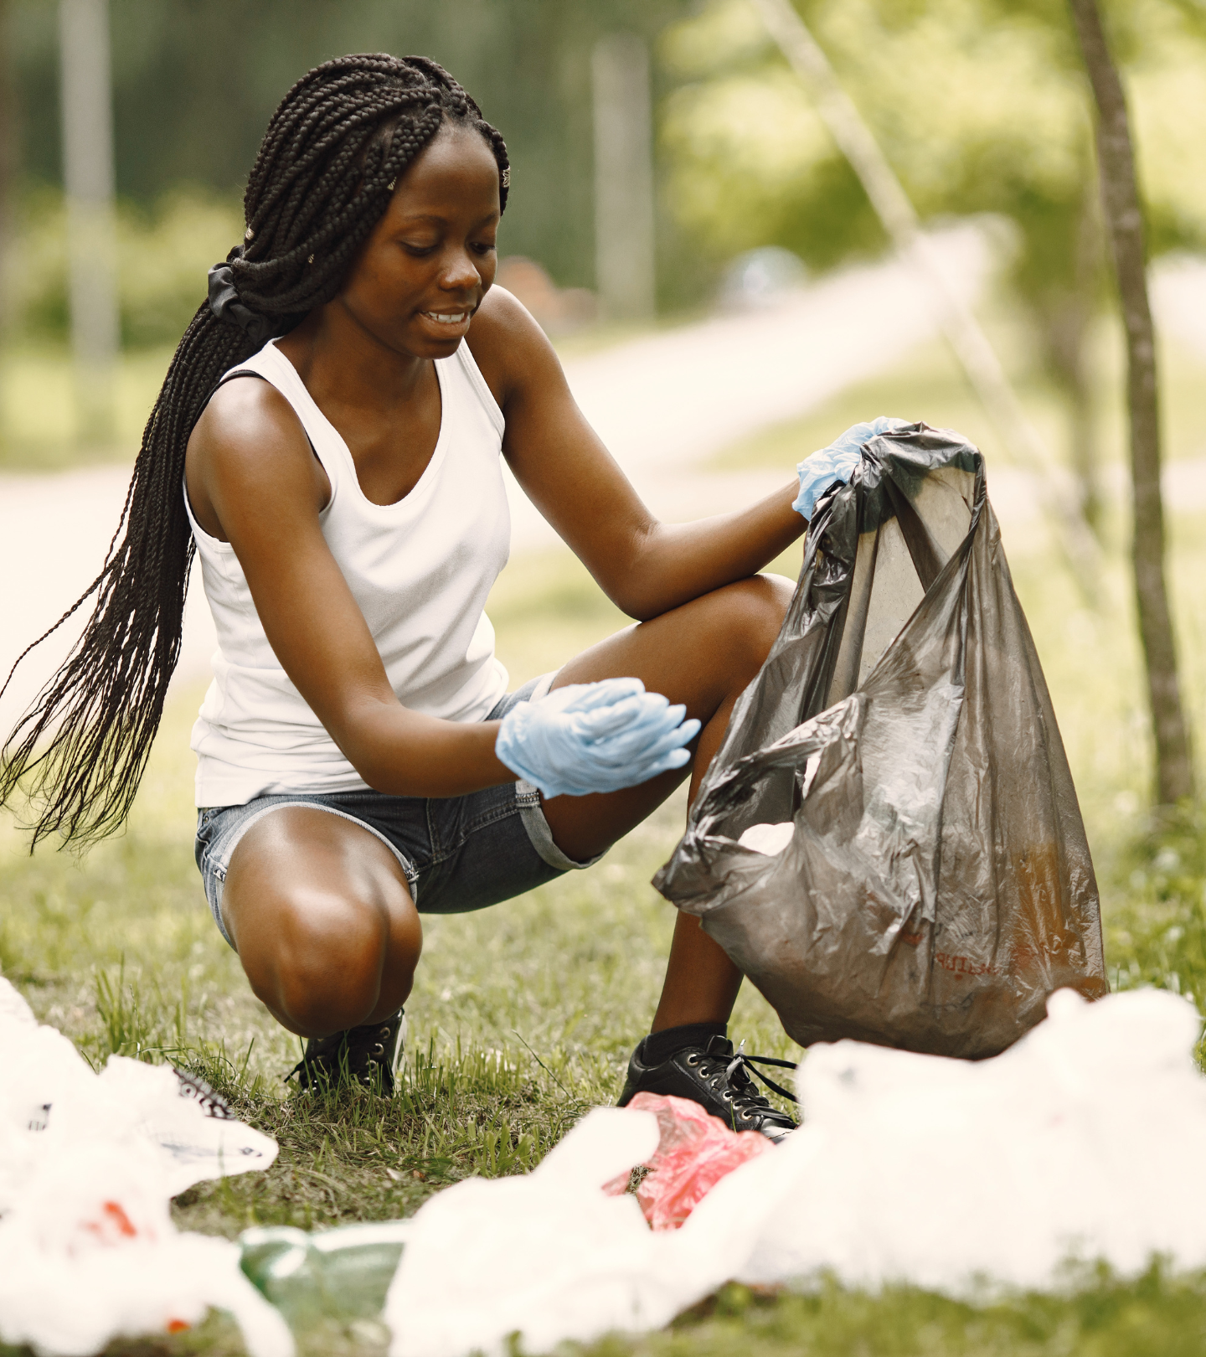
It’s a great for our physical health - walking around to pick litter is good exercise. More than half of those that took part in last year’s Great Big School Clean agreed that it helped them to be more active.
It’s great for mental health - you’re outdoors connecting with nature and other people, whilst doing something good… and doing good feels great! 81% of those surveyed after last year’s campaign agreed that taking part helped to improve their mood.

Slide 17
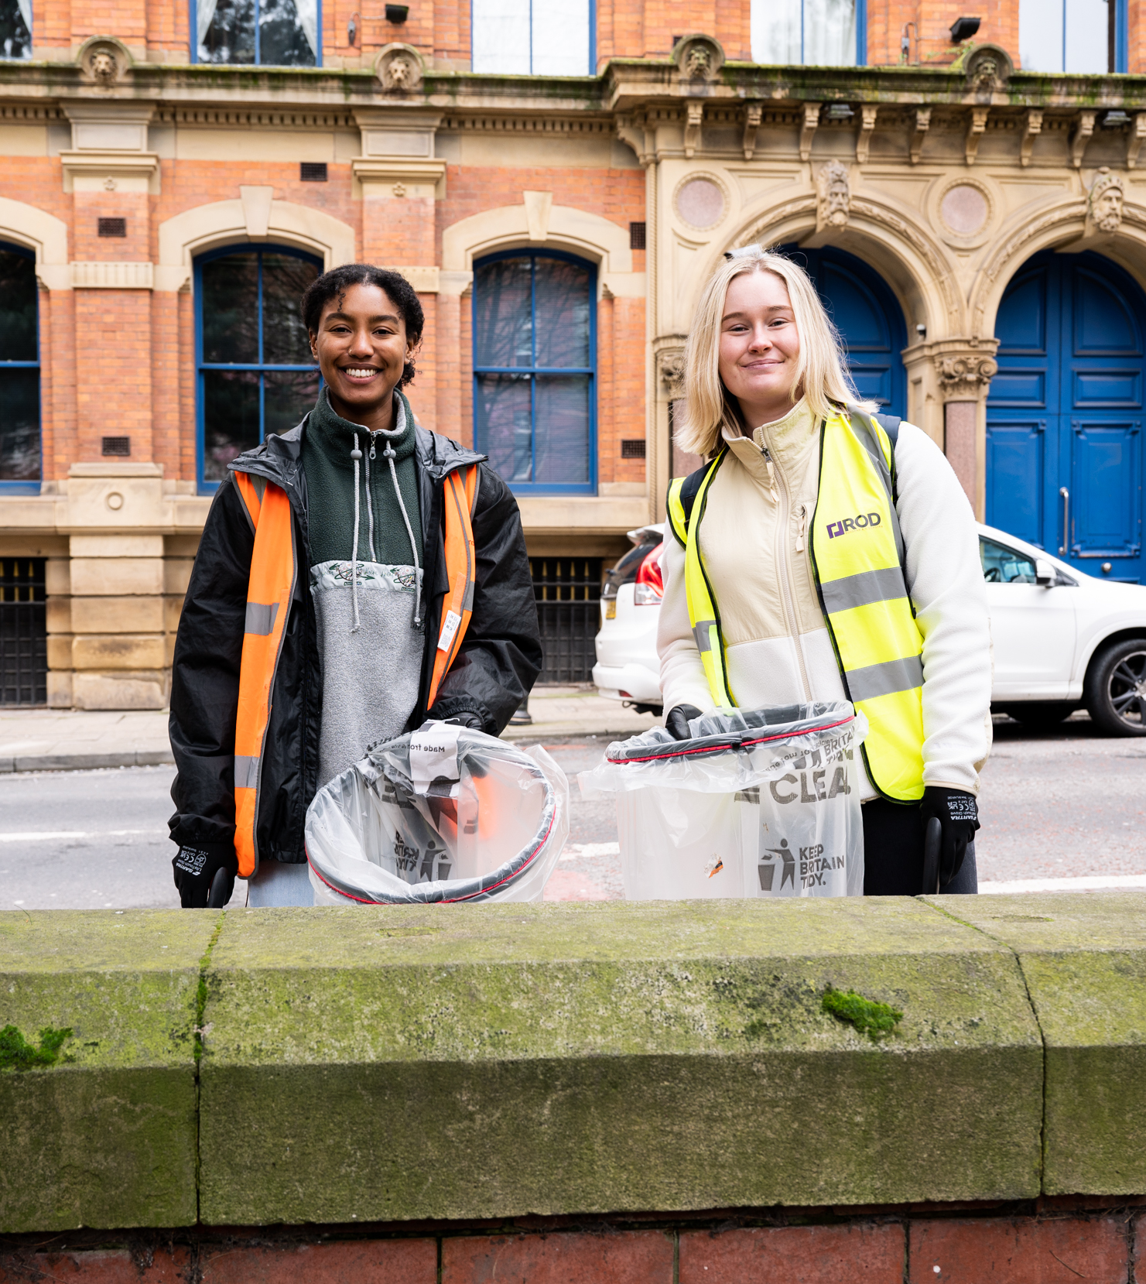
The Great Big School Clean
Keep Britain Tidy’s Great Big School Clean is our country’s biggest mass-action environmental campaign.
Last year, hundreds of thousands of litter-heroes took part and 95% of them said that they had improved their local community and felt great doing it!
To take action on litter, we’ve decided to join the campaign.

Slide 18
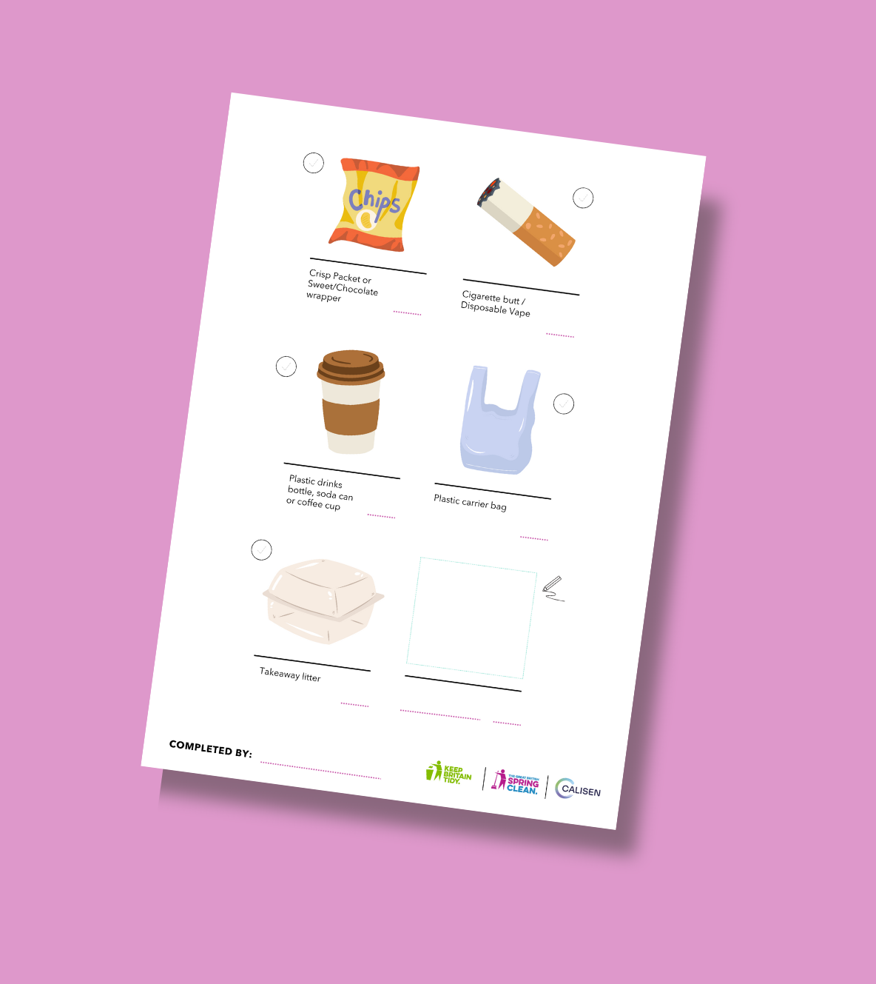
This year we have pledged that our school will pick (insert) bags of litter between (insert dates).
Come join us at (add your details here).
Finally, if you wanted to complete your own litter-pick with friends or family as part of the Great Big School Clean, you can! We will be sharing a litter-picking activity for you to take home and complete with your families and friends.

Slide 19
