Slide 1
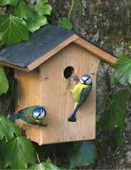
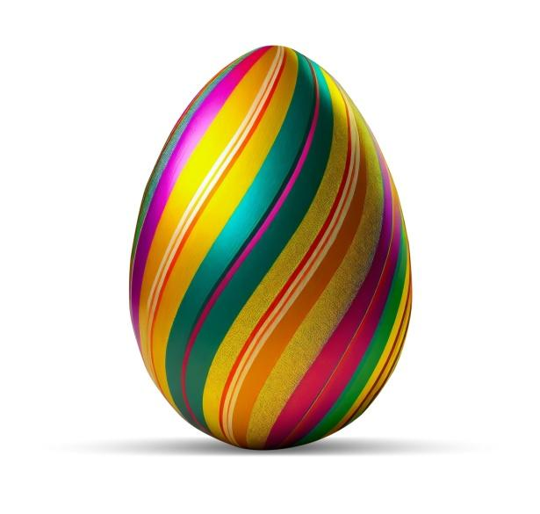
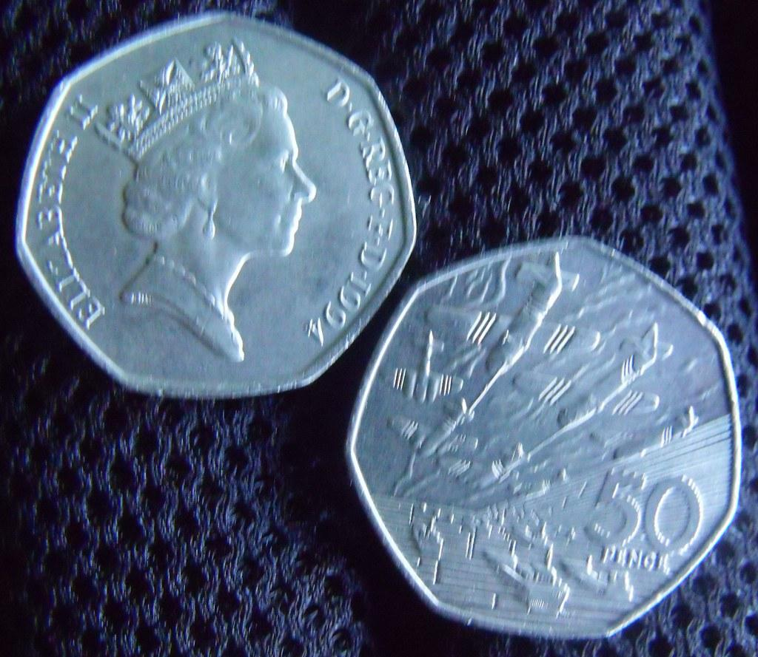
INSTRUCTIONS: you have to draw any British bird like a robin.You can draw, colour it in or paint it make it as realistic or cartoony as you want.
Bird drawing competition
Information:
The winner in each year group will win an Easter egg.
50p to enter.
The money will go towards buying bird houses
Hand entries into the HIP!

