Slide 1











Slide 2
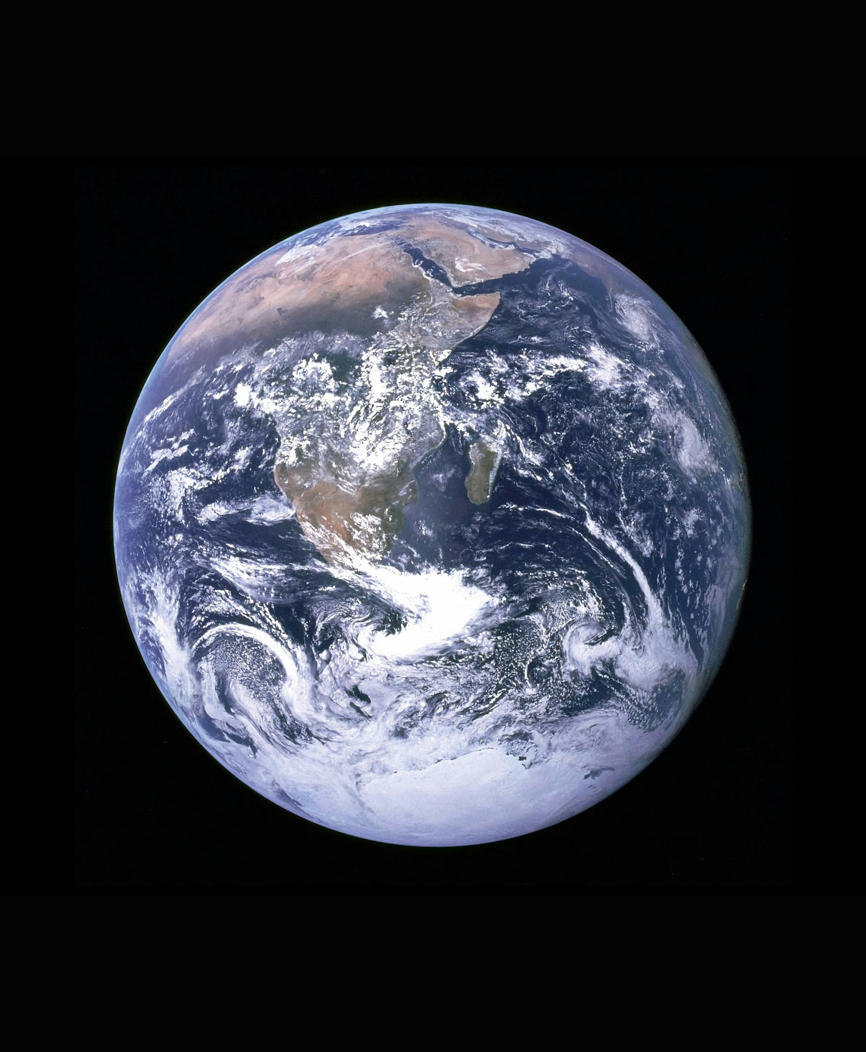

Why is carbon important?
If the temperature of Earth was based only on our size and distance from the sun, the average global temperature would be -18°C!
Fortunately, there are gases in our atmosphere that trap heat and stop it from escaping. This makes the global average temperature 14°C, perfect for living things.
Photo by NASA

Slide 3


We call these gases ‘Greenhouse Gases’ because like the glass of a
greenhouse, they trap heat.
Many of these greenhouse gases contain carbon.
Photo by Nathan Dumlao on Unsplash

Slide 4
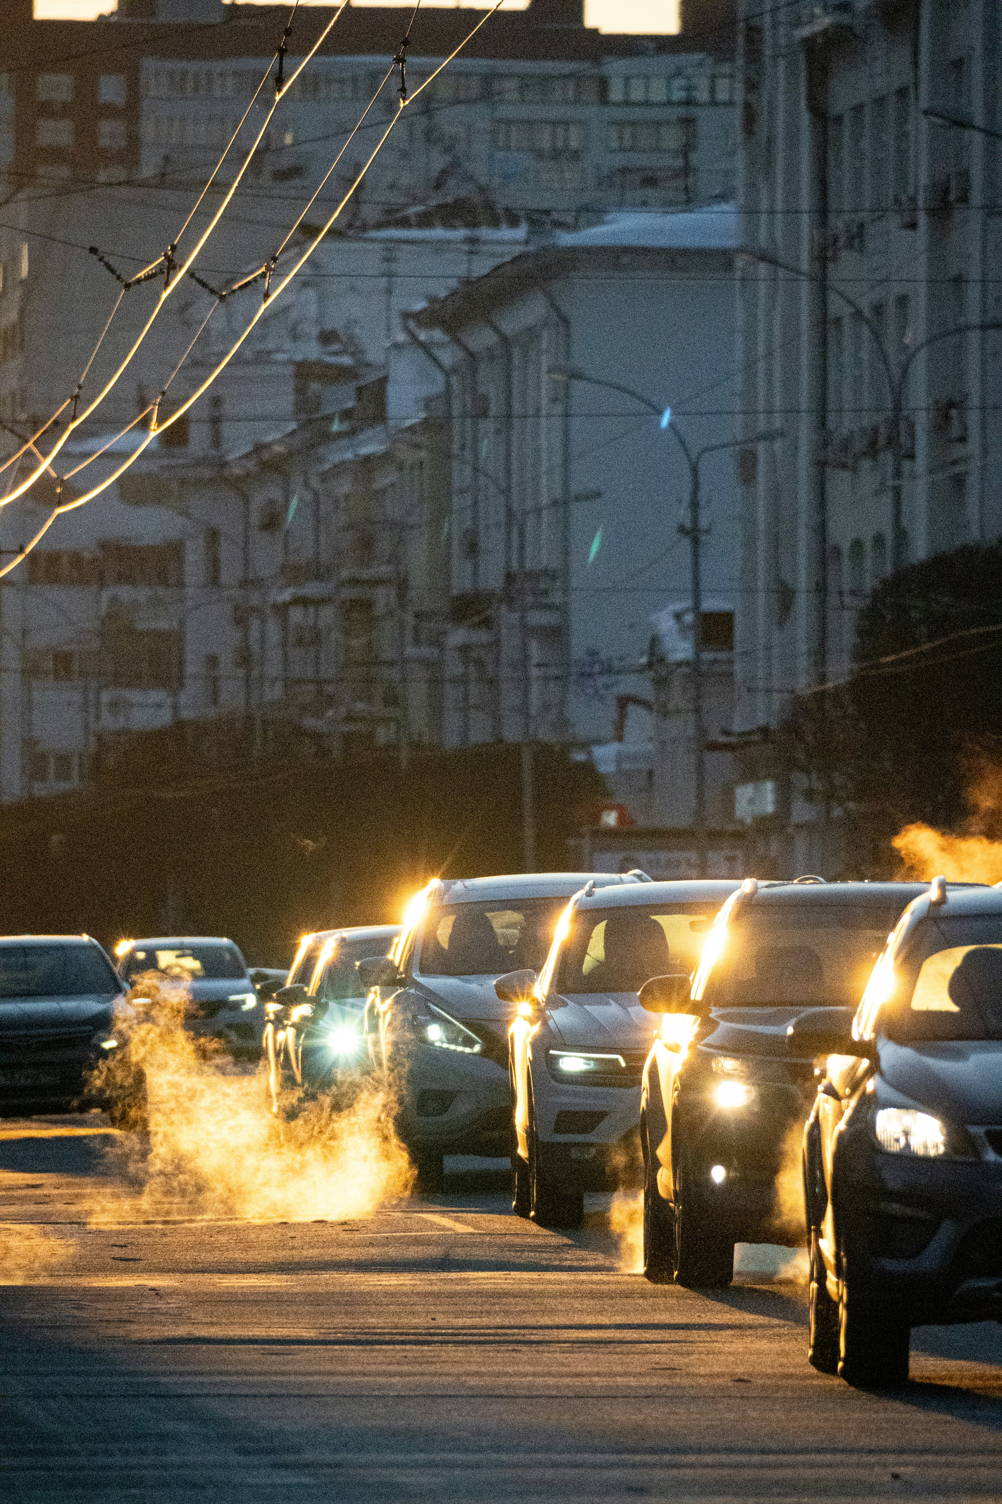
Photo by Ainur Khakimov on Unsplash
Why should we cut our carbon?
Every day humans generate energy, drive cars, grow food, and power factories. These activities can release huge amounts of greenhouse gases into the atmosphere.
More greenhouse gases means more trapped heat. This is making Earth warmer, creating ‘climate change’.

Slide 5
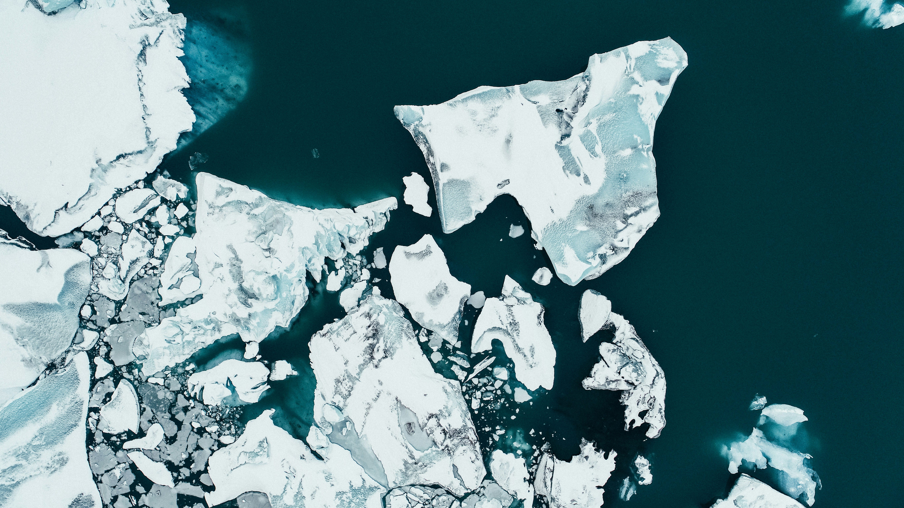
Climate change is harming our planet, melting ice caps and creating dangerous weather events including drought, and floods.
Photo by shawnanggg on Unsplash

Slide 6
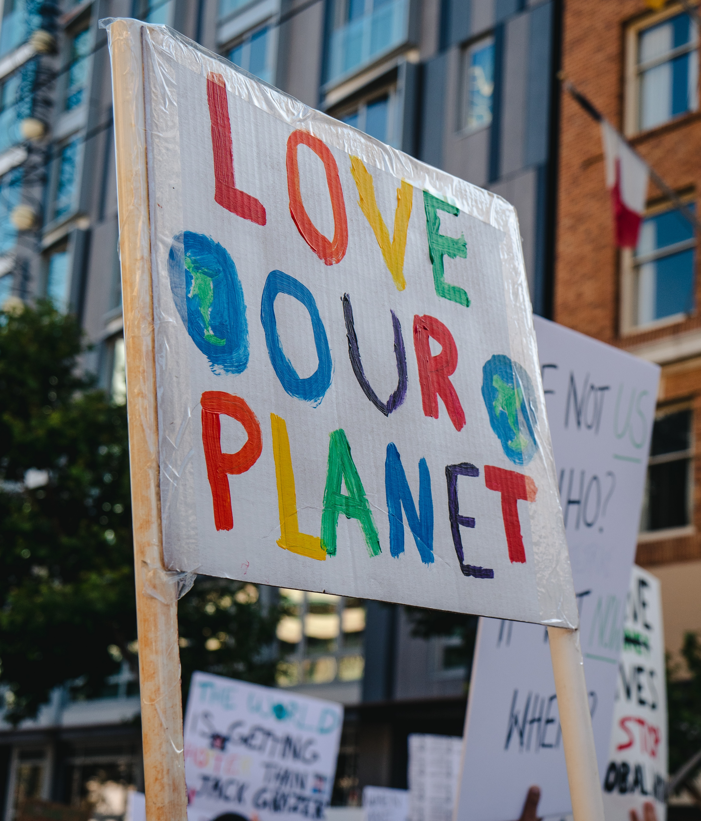
It’s time to push back against climate change.
It’s time to shout loud and inspire everyone to act.
It’s time to Cut Your Carbon!
Photo by Ronan Furuta on Unsplash

Slide 7
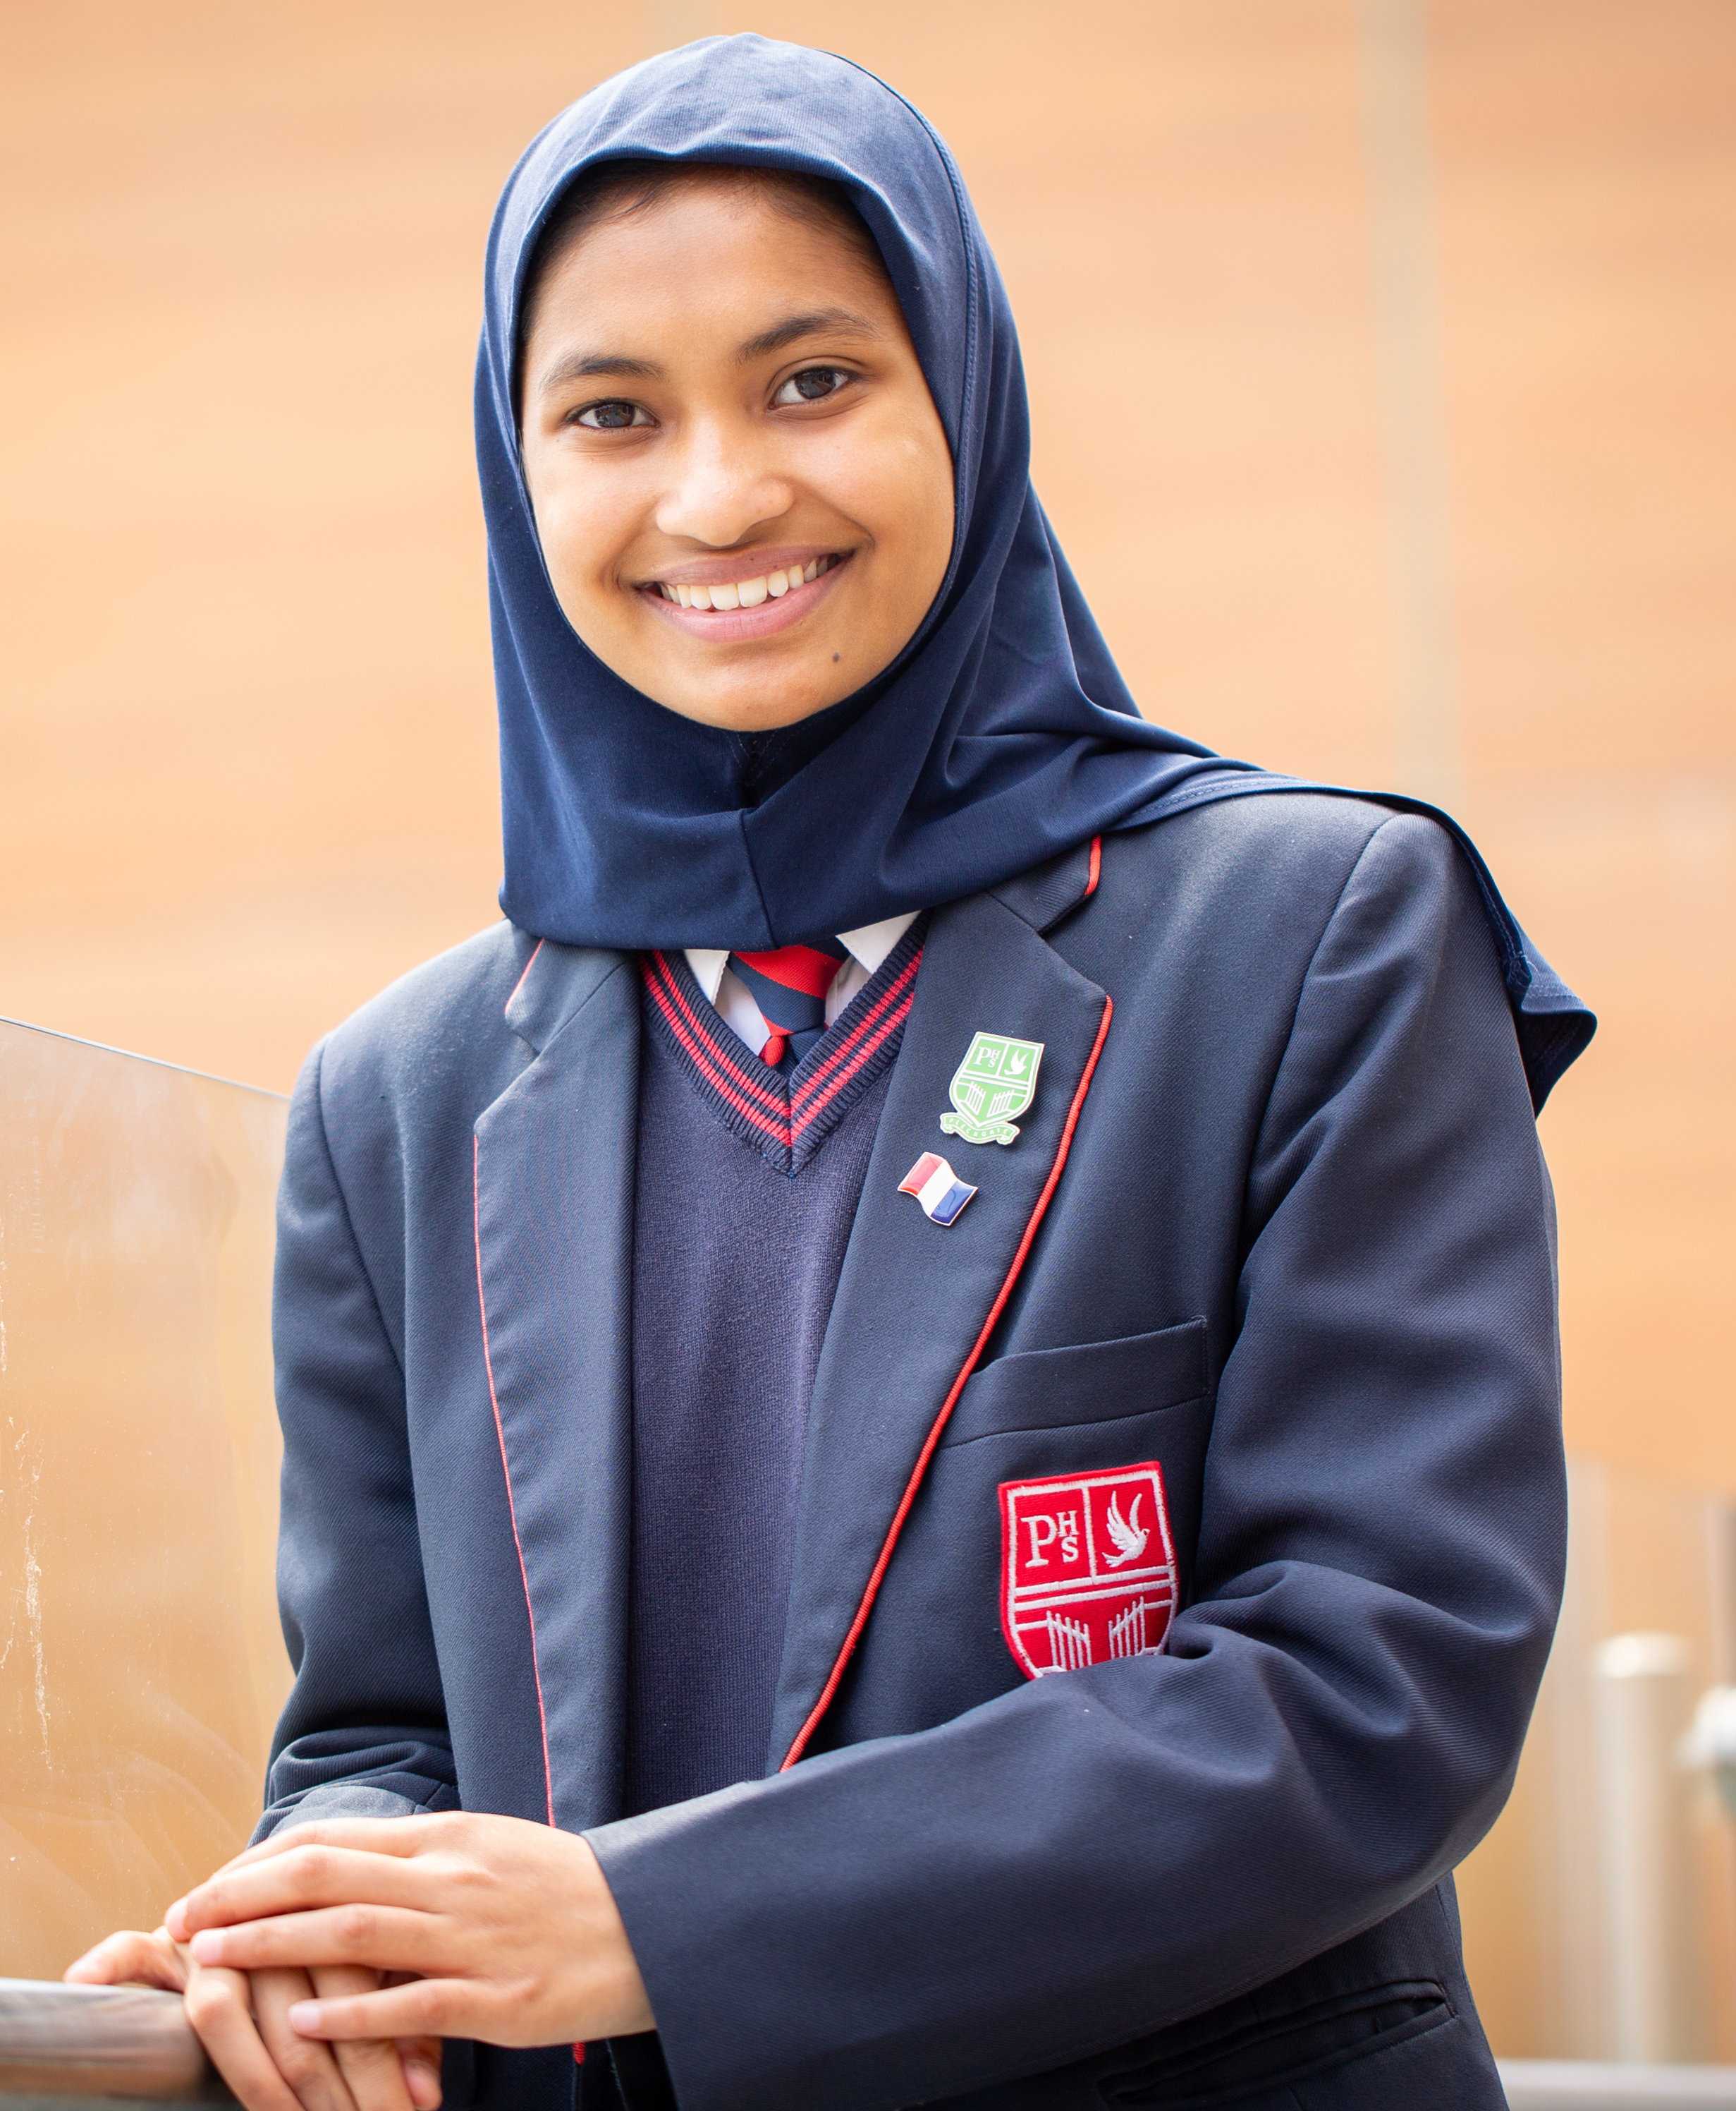
What can we do ?
Governments must act and big businesses need to change.
But we can also play a part. Making small daily changes can add up to make a big difference.
We’re challenging you to complete 6 small activities across November, at home, with friends and family. Each activity will reduce your carbon emissions and inspire others to act.

Slide 8

What next?
All pupils will get a Cut Your Carbon checklist.
You can take this home and use it to help guide you, your family, and your friends to cut your carbon.
At the end of November, we’ll count how many pupils completed each action and celebrate our efforts together.

Slide 9




EcoSchoolsEngland
@ecoschools
@ecoschools_england
www.eco-schools.org.uk

